Slide 1
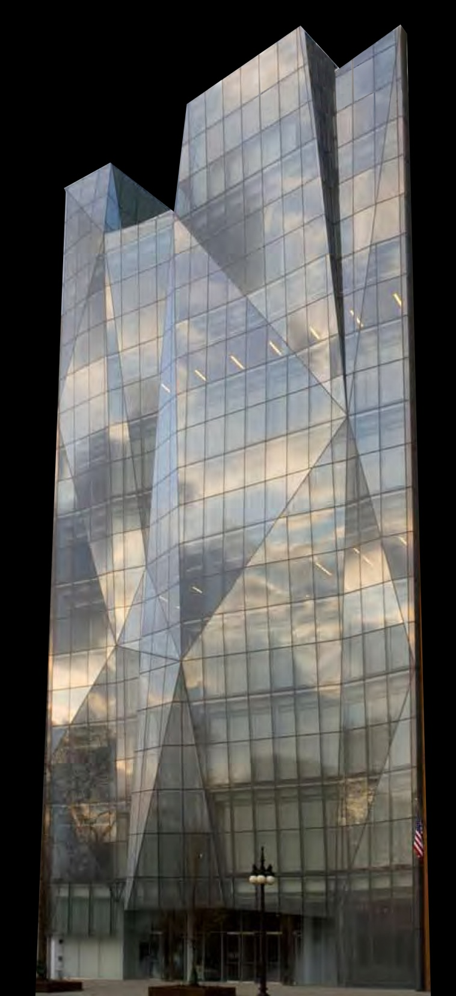
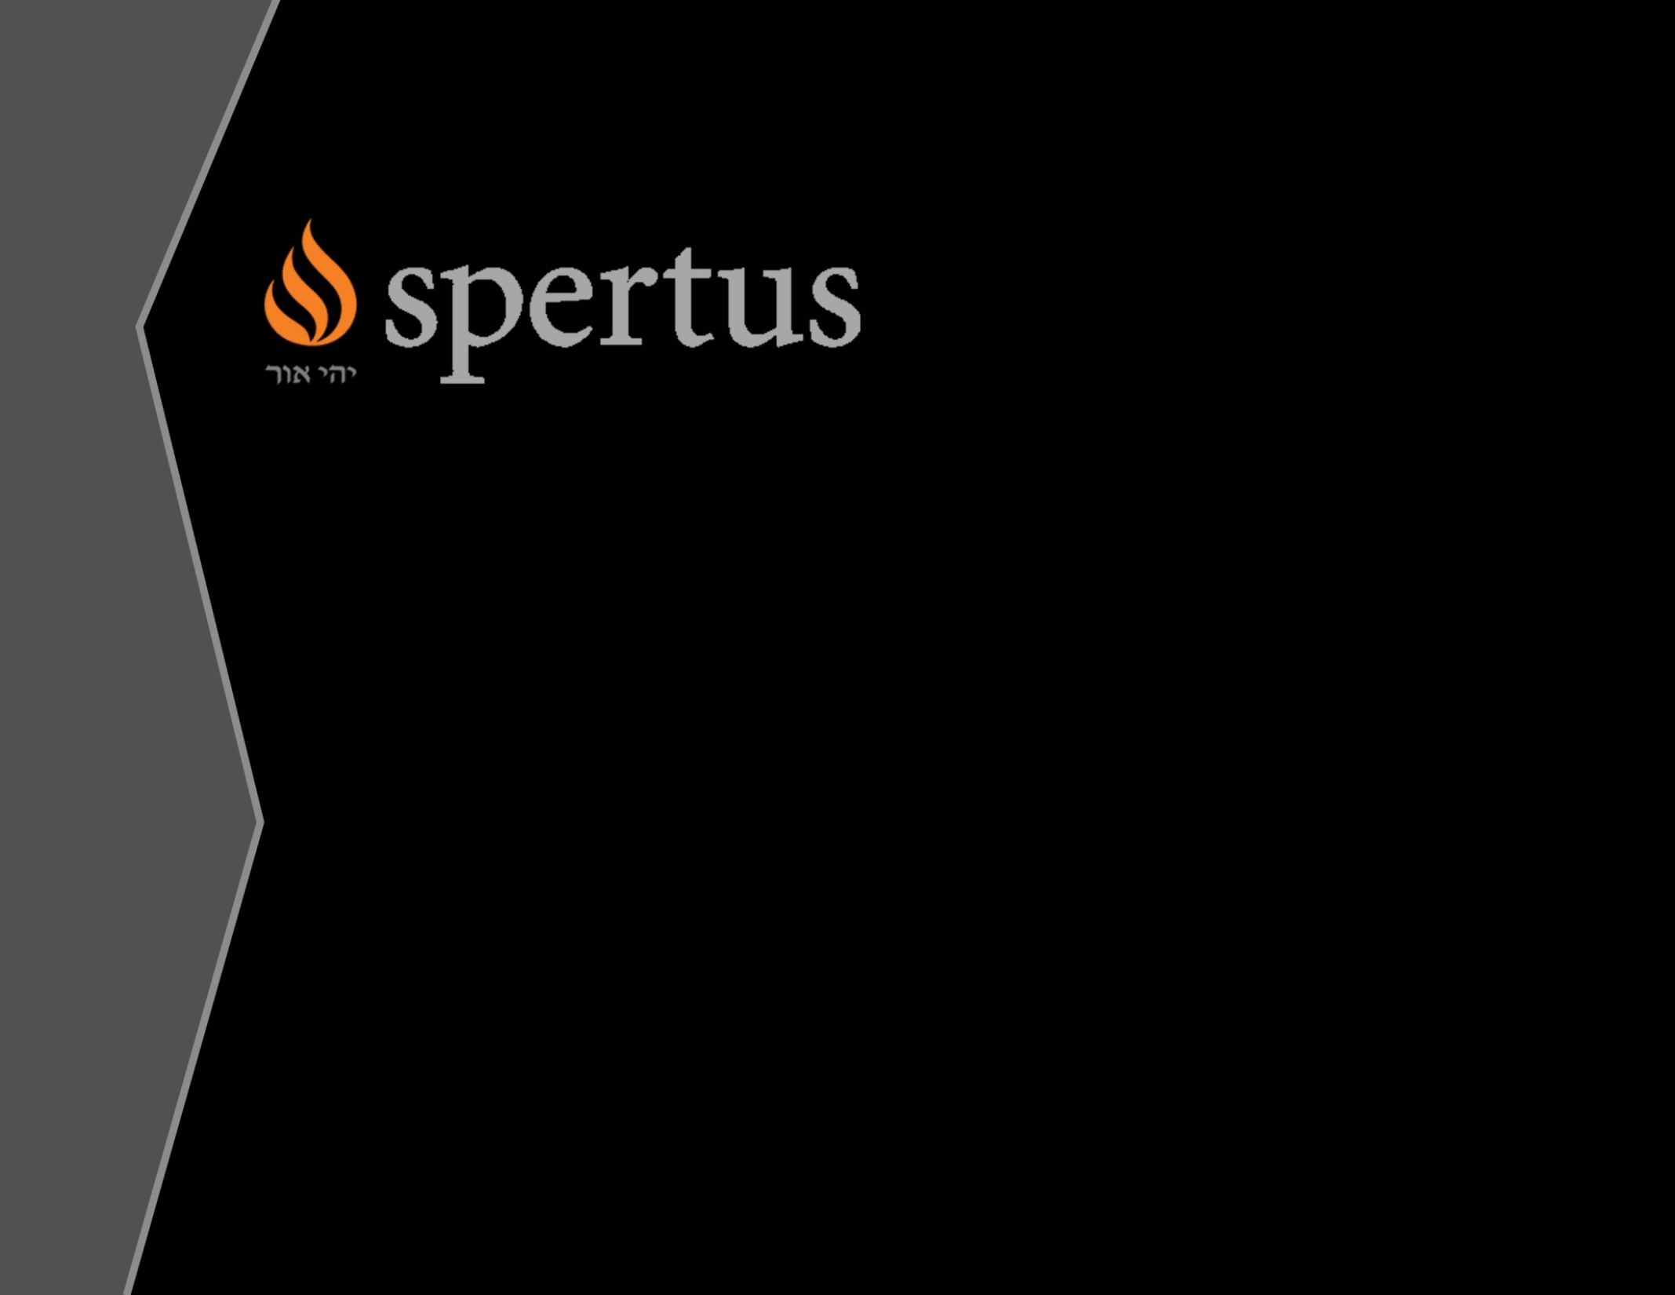
Kanis Glaewketgarn
Lighting / Electrical l AE Senior Thesis l April 14, 2009

Slide 2
Kanis Glaewketgarn’s AE Senior Thesis
WELCOME
Institute of Jewish Studies

Slide 3

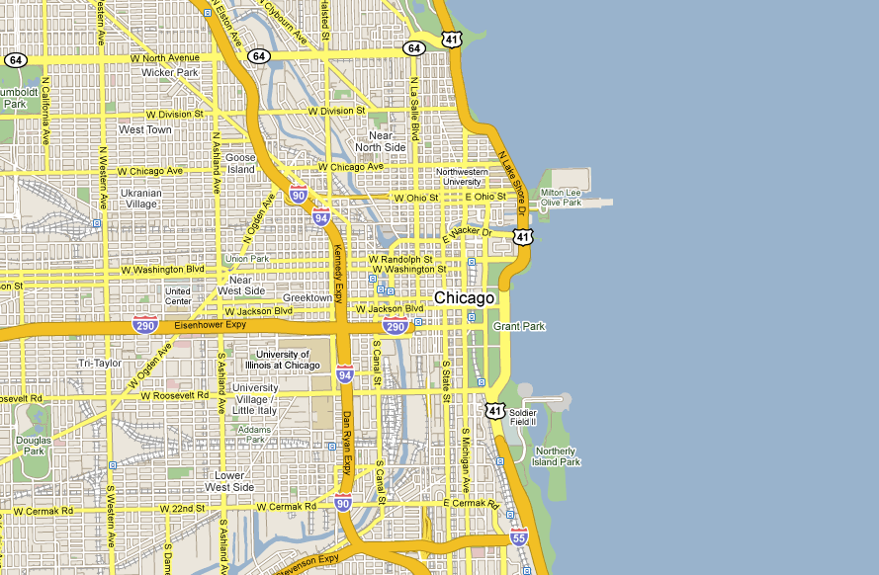
PROJECT OVERVIEW

Slide 4
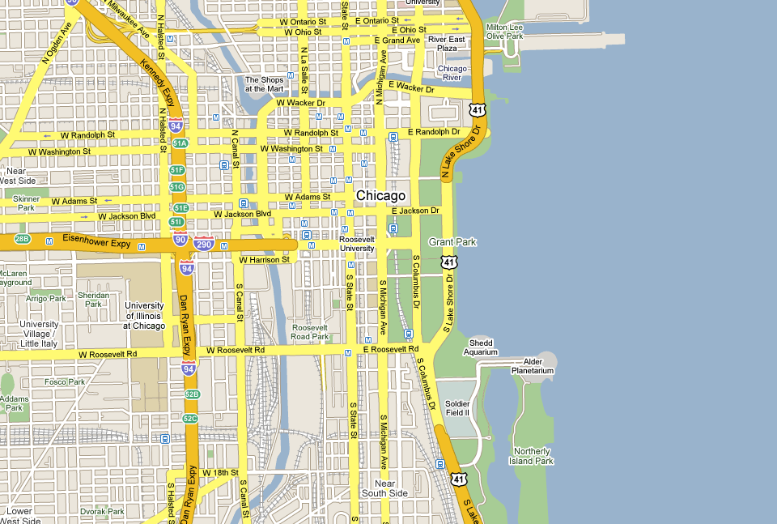
PROJECT OVERVIEW

Slide 5
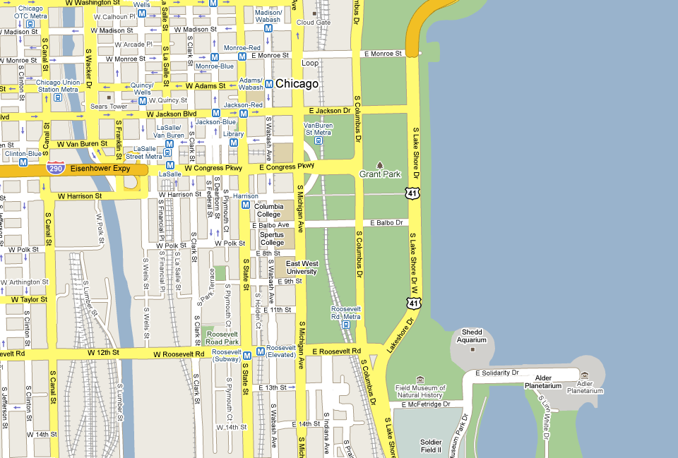
PROJECT OVERVIEW

Slide 6
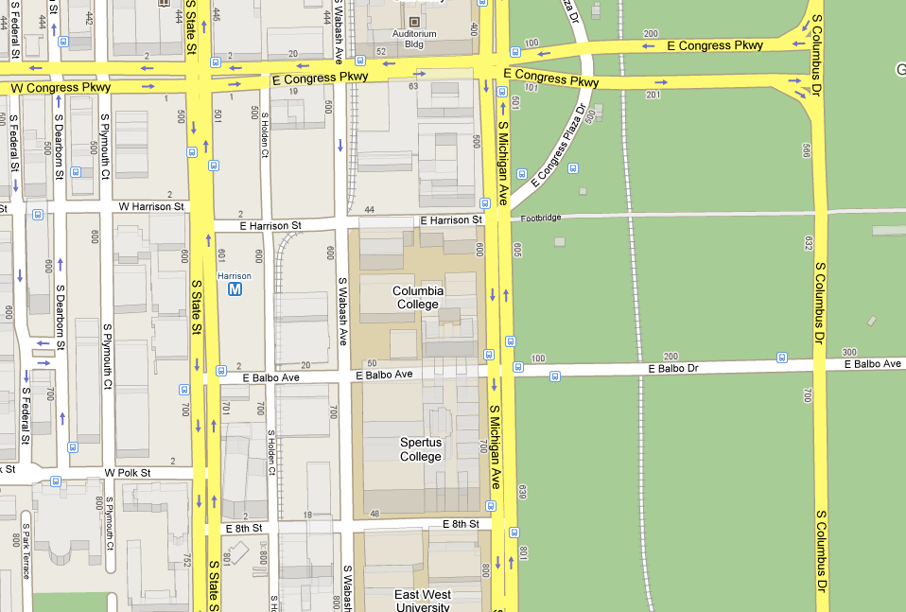
PROJECT OVERVIEW

Slide 7
PROJECT OVERVIEW

Slide 8
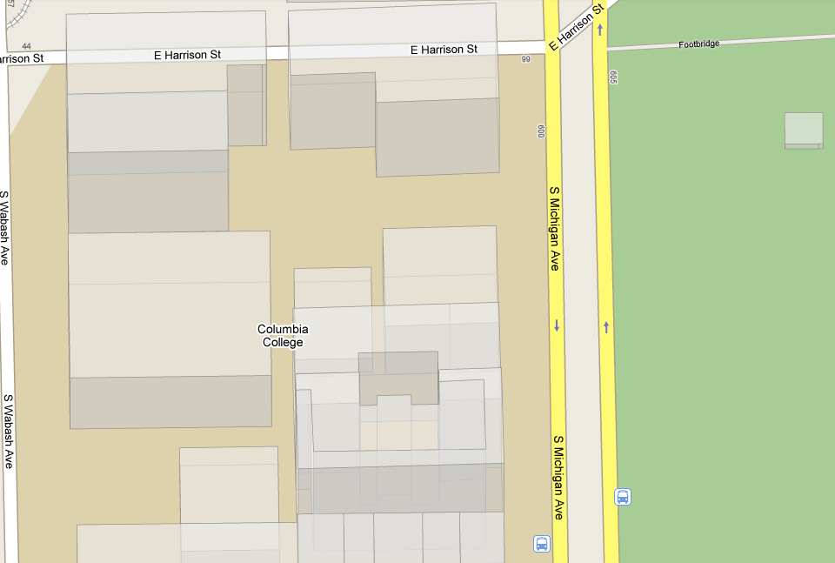
PROJECT OVERVIEW

Slide 9
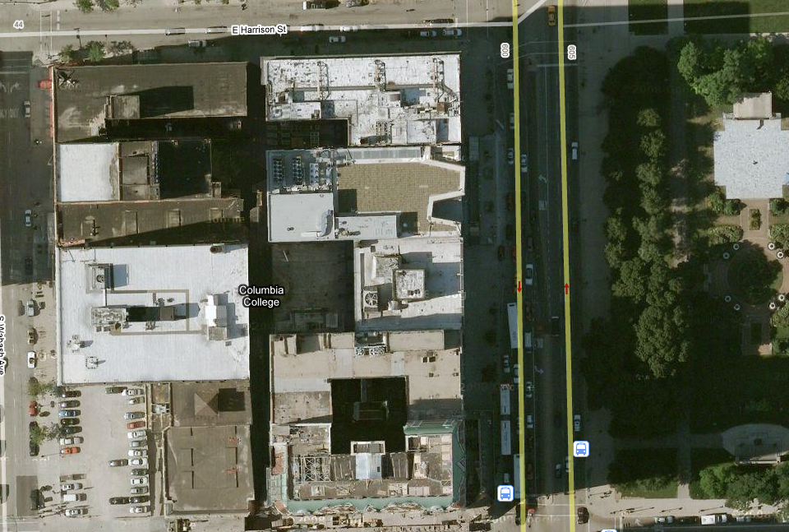
PROJECT OVERVIEW

Slide 10

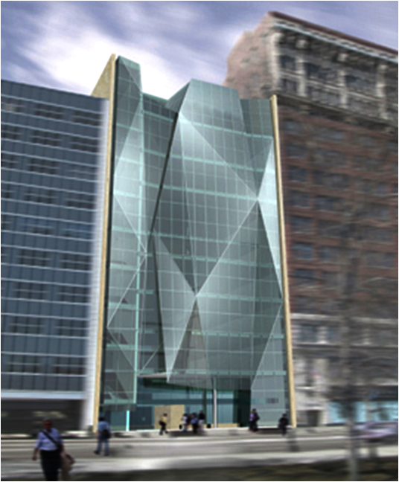
PROJECT OVERVIEW
Building name:
Key project team:
Location and site:
Space types:
Size:
Number of stories:
Spertus Institute of Jewish Studies
Architect – Krueck+Sexton
Lighting Design – Schuler Shook
MEP – Environmental System Design
Structural Engineer –Tylk Gustafson Reckers Wilson Andrews
General Contractor – W.E. O’Neil Construction Co.
610 S. Michigan Ave Chicago IL 60605
Museum
College
Library
155,000 Sq.ft.
11

Slide 11
SCOPE OF WORK
Lighting Redesign
Electrical Redesign
Electrical Depth
Breadth Study
Building Façade
Lobby Atrium
Feinberg Theater
Open Office
Four Spaces
Energy Efficient Loads
Energy Efficient Transformers
Acoustics
Design Integration

Slide 12
SCOPE OF WORK
Lighting Redesign
Electrical Redesign
Electrical Depth
Breadth Study
Building Façade
Lobby Atrium
Feinburg Theater
Open Office
Four Spaces
Energy Efficient Loads
Energy Efficient Transformers
Acoustics
Design Integration

Slide 13
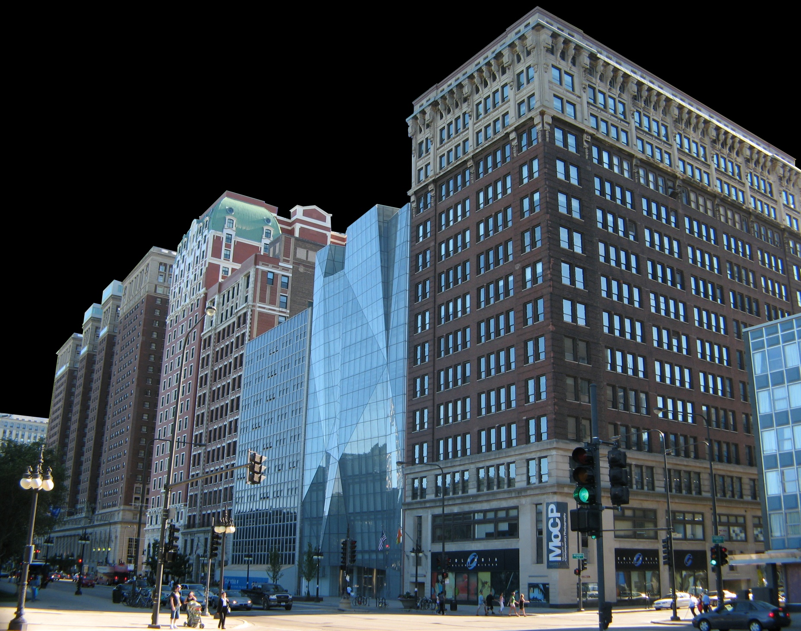
ARCHITECTURAL CONCEPT
O U T L I N E
Architectural Concept
Lighting Redesign
  Lobby Atrium
  Feinberg Theater
Daylighting Study
Electrical Depth
  Energy Efficient Loads
Breadth Study
  Acoustics
To INTEGRATE and UNIFY what is generally seperated:
Library
Theater
Museum
Classrooms
Offices
To create a VERTICAL campus

Slide 14
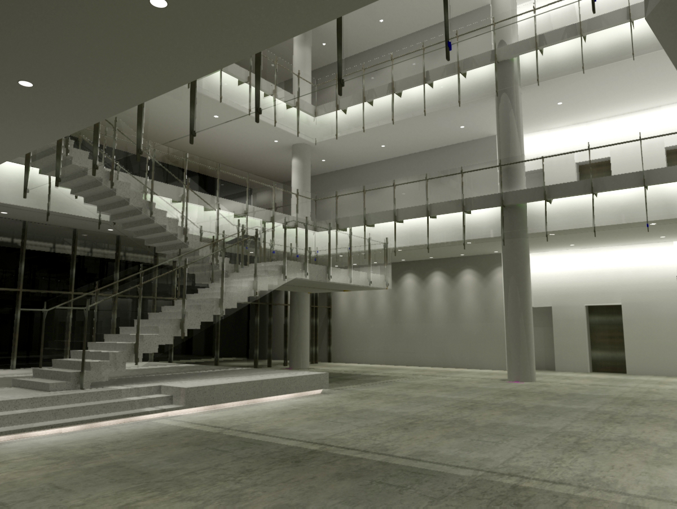
LIGHTING DESIGN OBJECTIVES
O U T L I N E
Architectural Concept
Lighting Redesign
  Lobby Atrium
  Feinberg Theater
Daylighting Study
Electrical Depth
  Energy Efficient Loads
Breadth Study
  Acoustics
Integrated lighting design solutions
Energy efficient equipment
Flexible lighting/control system

Slide 15
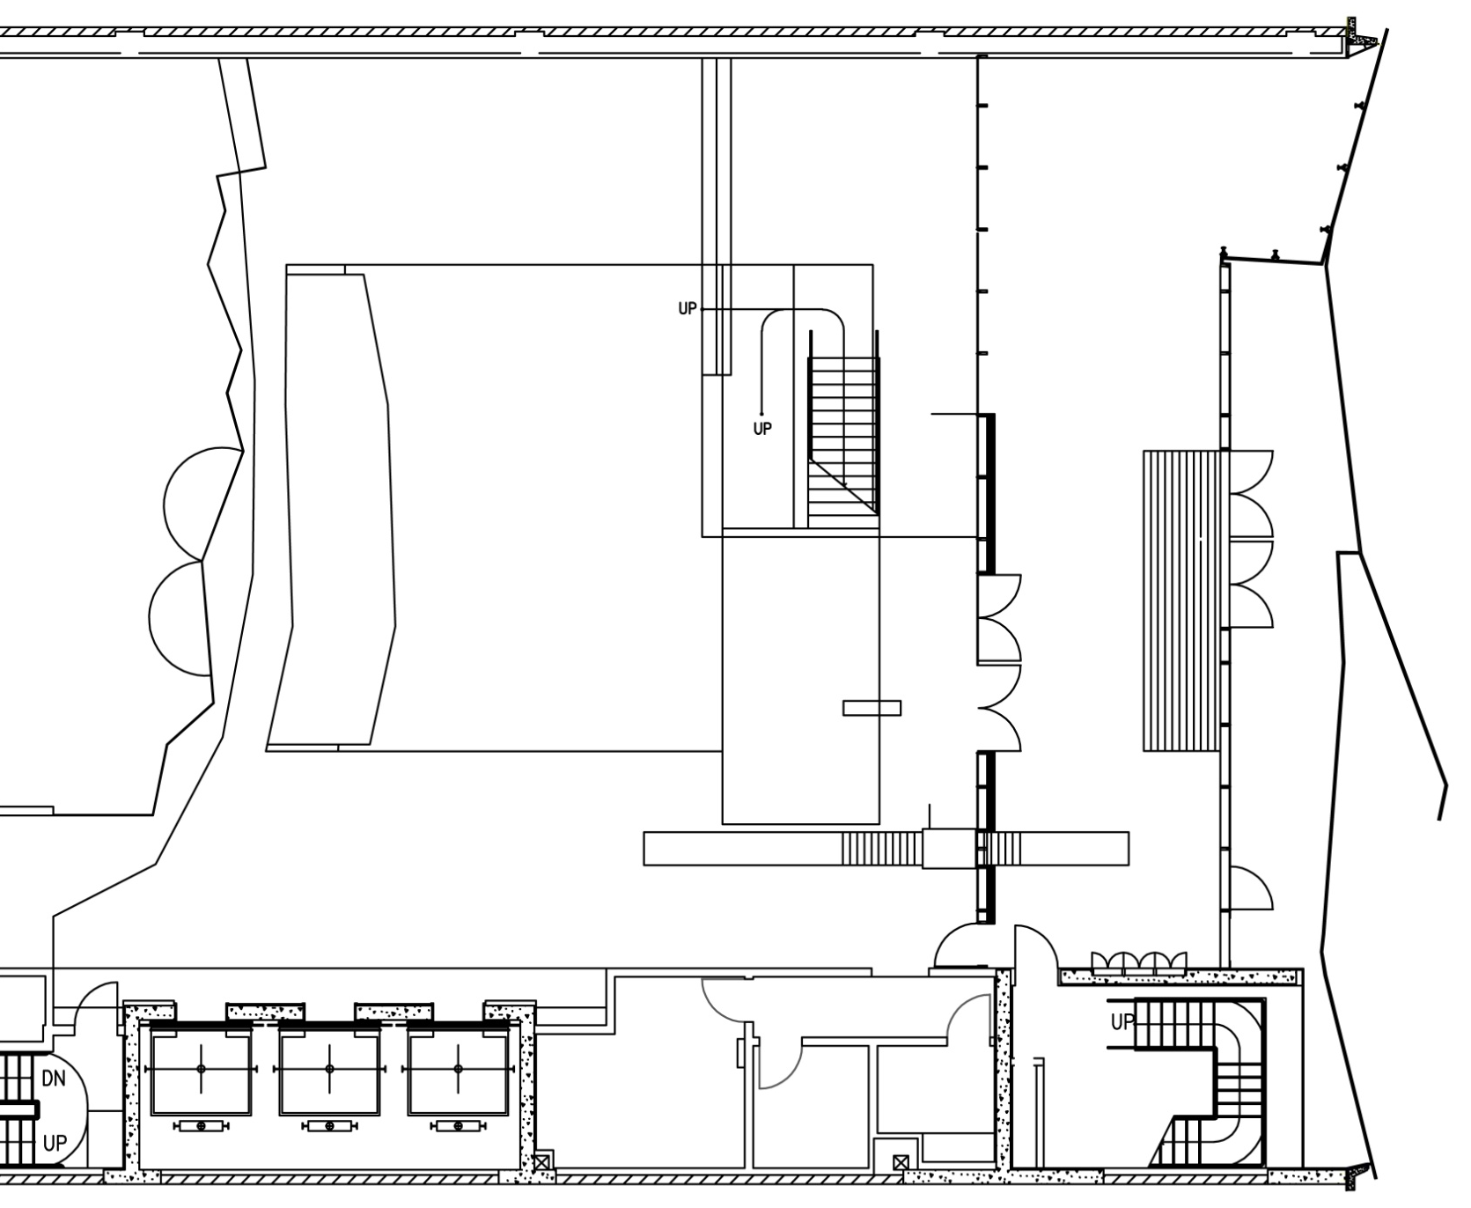
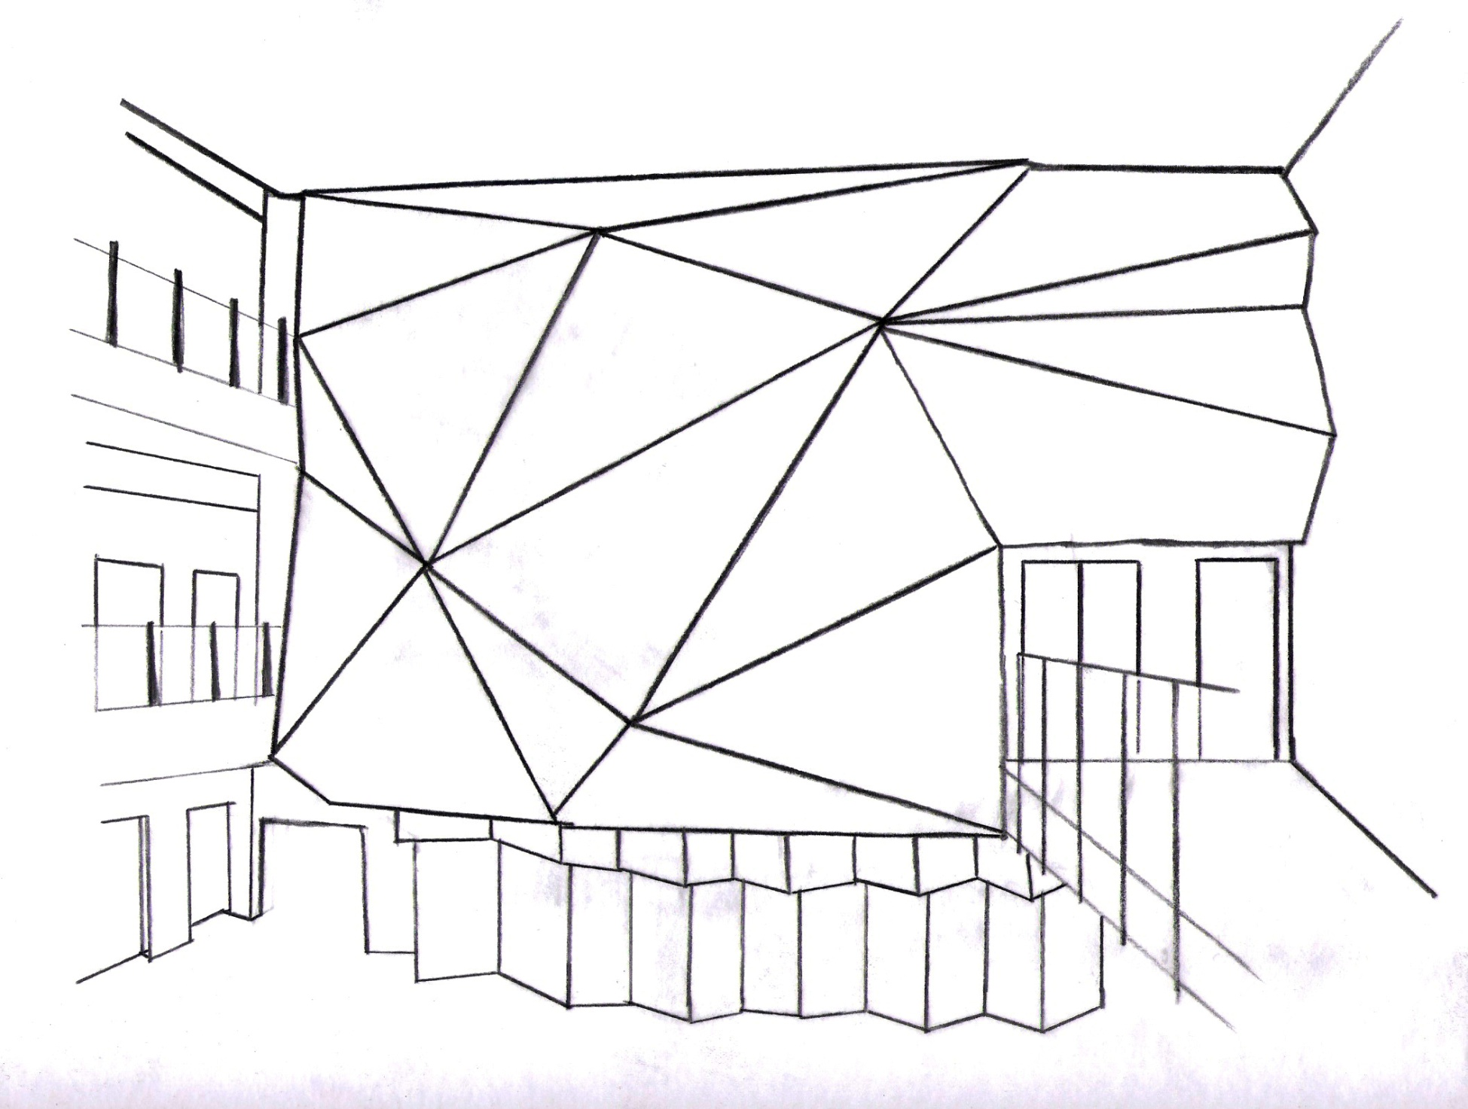
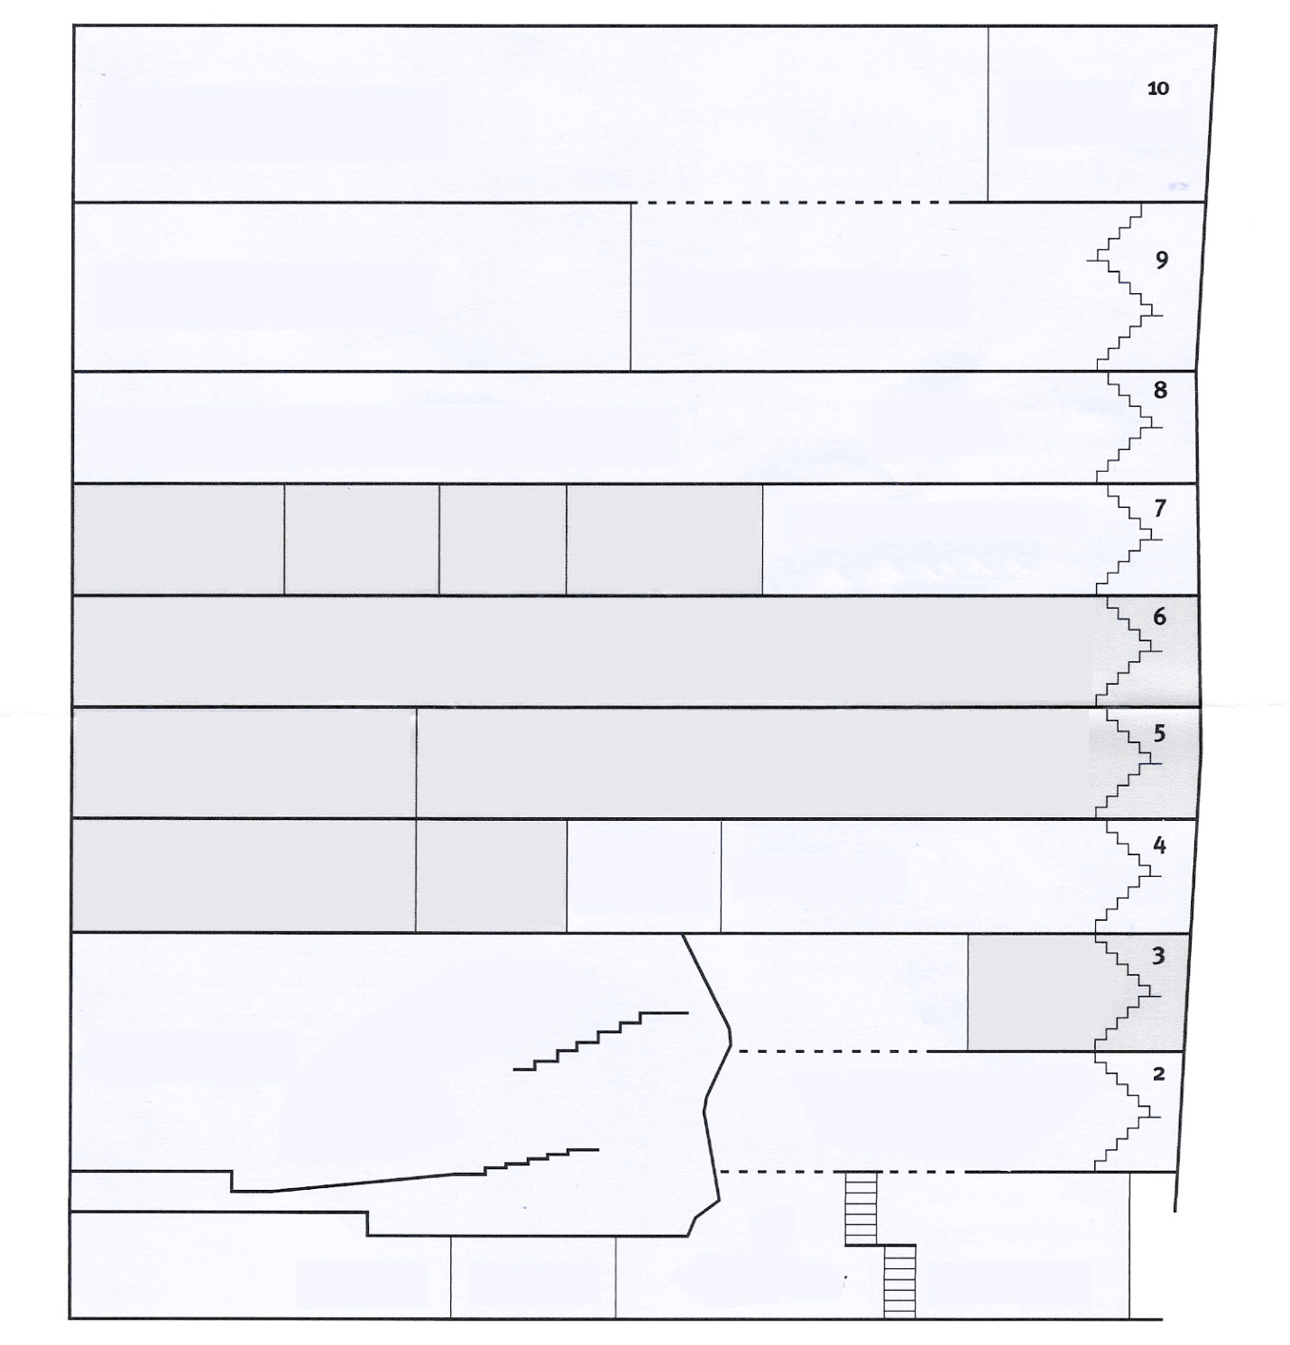
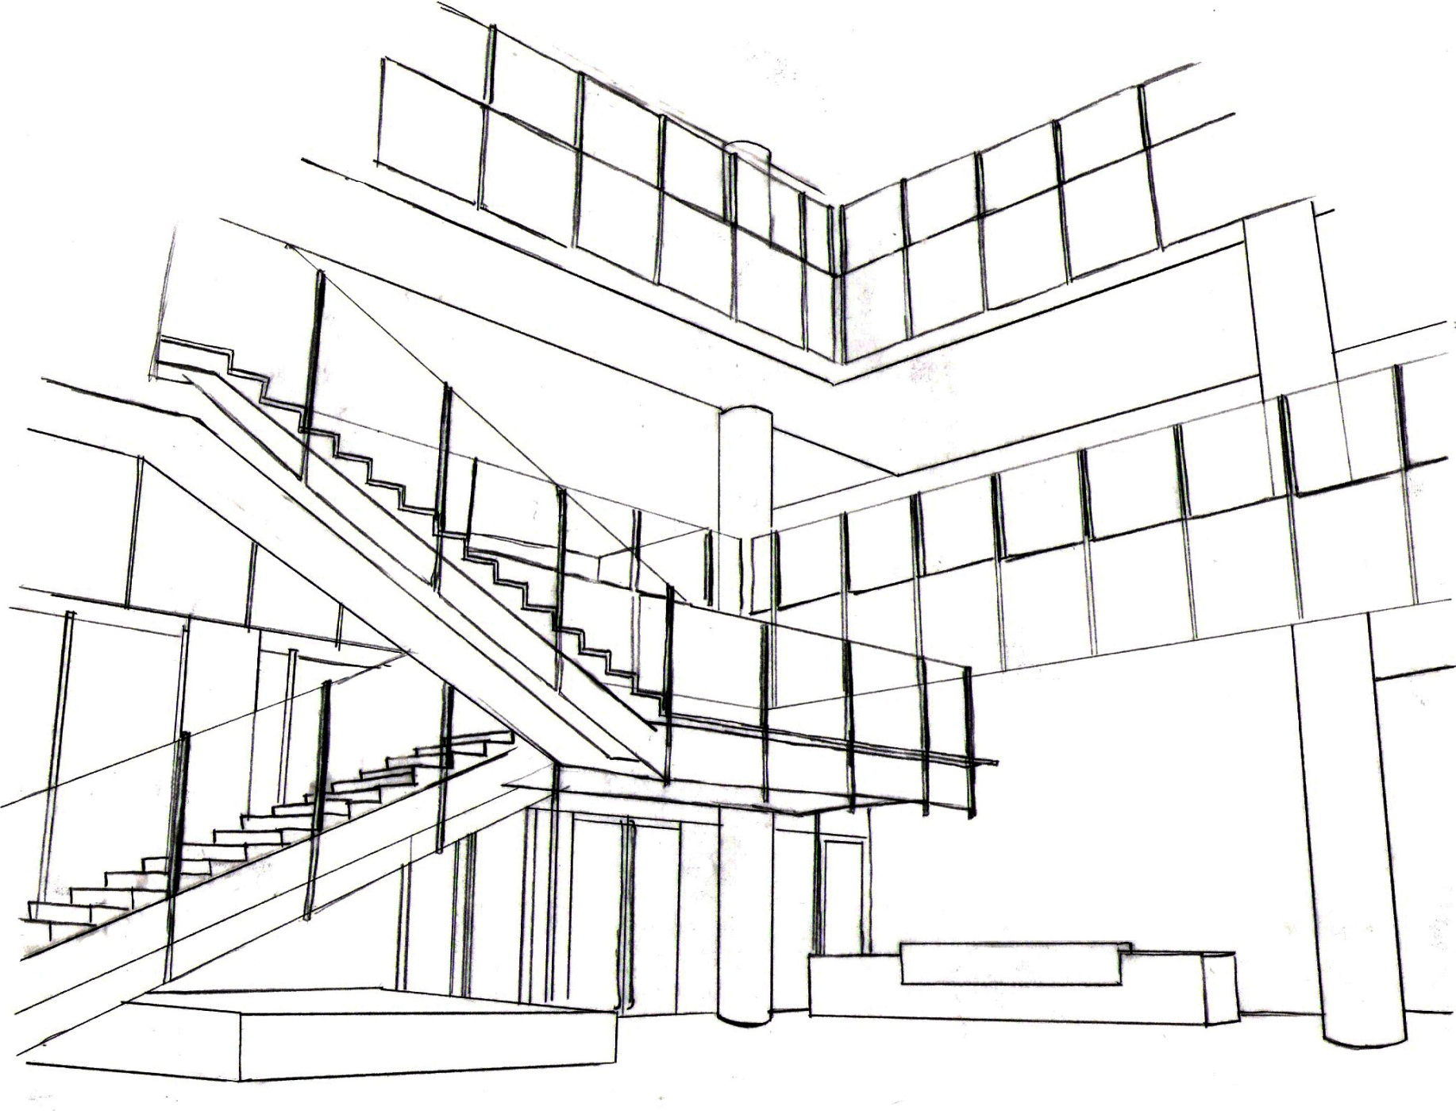
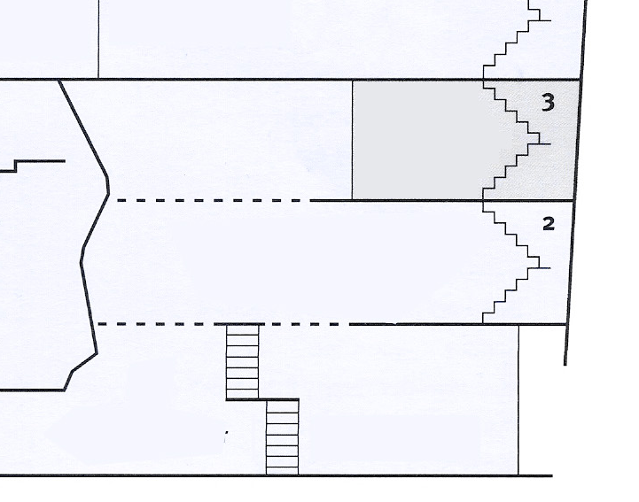
LIGHTING REDESIGN
LOBBY ATRIUM
O U T L I N E
Architectural Concept
Lighting Redesign
  Lobby Atrium
  Feinberg Theater
Daylighting Study
Electrical Depth
  Energy Efficient Loads
Breadth Study
  Acoustics
Visitor Services Desk
Lobby
Atrium
Visitor Services Desk

Slide 16
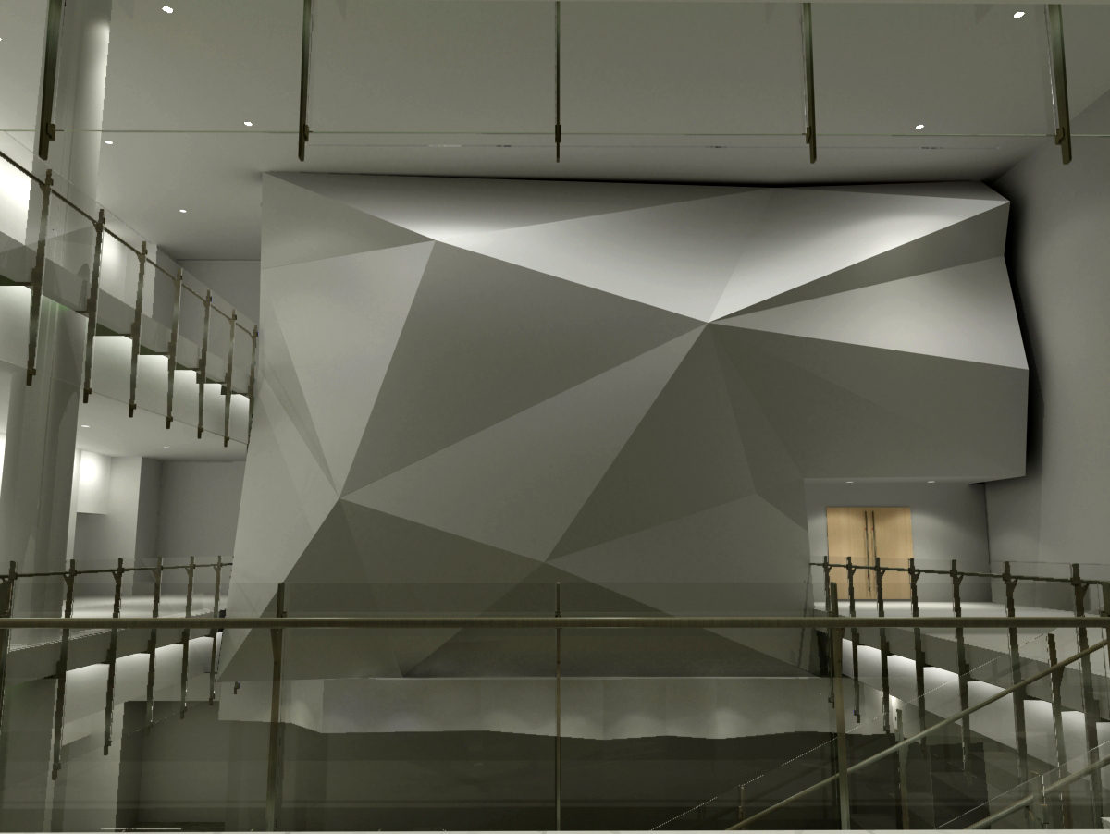
LIGHTING REDESIGN
LOBBY ATRIUM
O U T L I N E
Architectural Concept
Lighting Redesign
  Lobby Atrium
  Feinberg Theater
Daylighting Study
Electrical Depth
  Energy Efficient Loads
Breadth Study
  Acoustics
Visual Environment
Appearance of the space
Color appearance
Highlights and focal point
Way-finding / Direction / Orientation
Visual Performance
10 FC on the ground
System Control and Flexibility

Slide 17
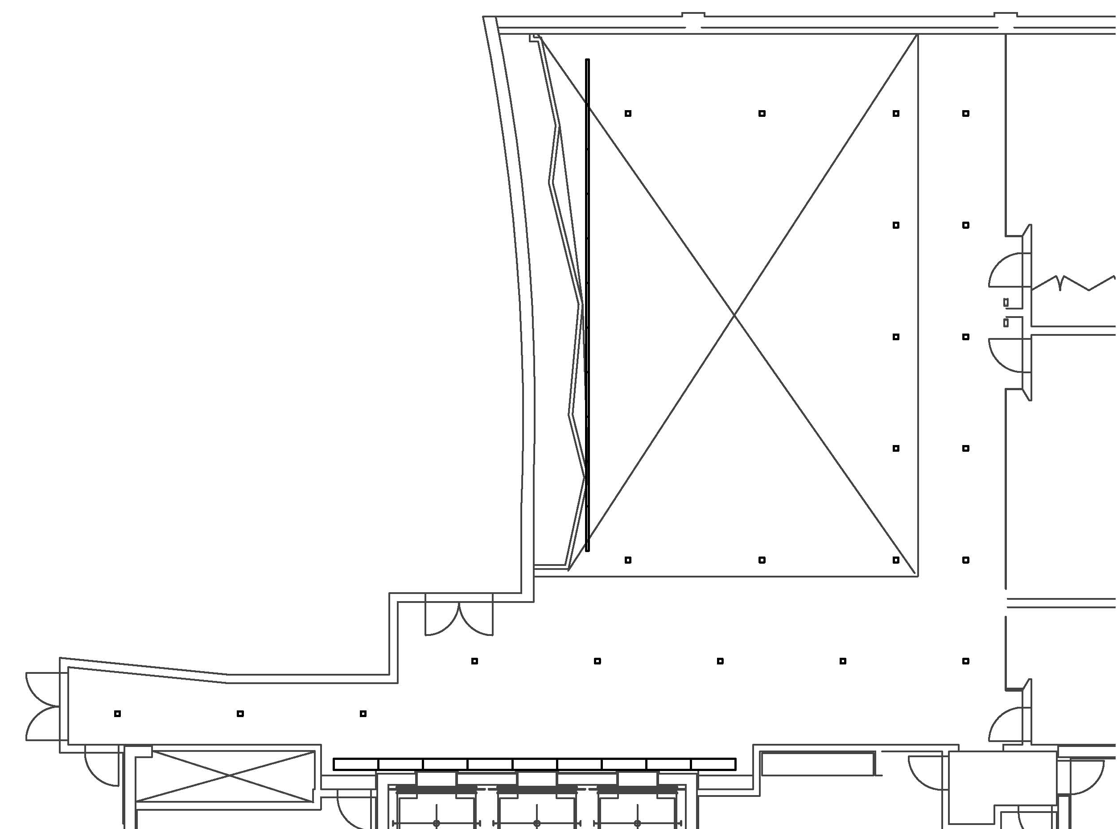
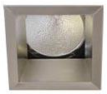
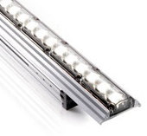
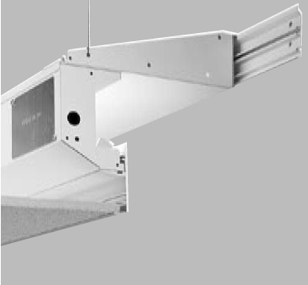
LIGHTING REDESIGN
LOBBY ATRIUM
O U T L I N E
Architectural Concept
Lighting Redesign
  Lobby Atrium
  Feinberg Theater
Daylighting Study
Electrical Depth
  Energy Efficient Loads
Breadth Study
  Acoustics
70W T6 Ceramic Metal Halide Downlight
20W T4 Ceramic Metal Halide Downlight
Linear LED
T5 Linear Fluorescent Cove

Slide 18
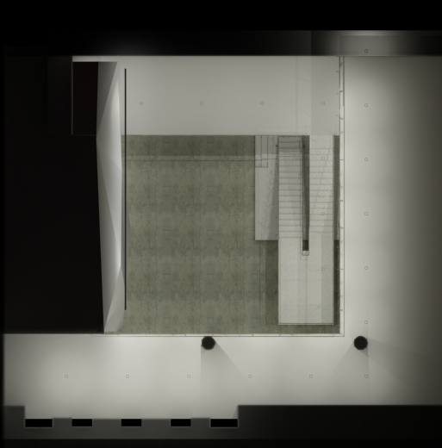
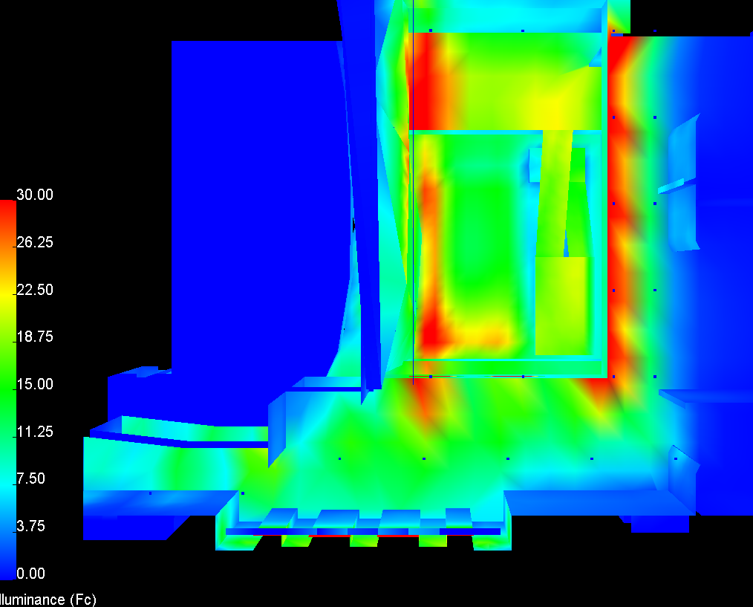
LIGHTING REDESIGN
LOBBY ATRIUM
O U T L I N E
Architectural Concept
Lighting Redesign
  Lobby Atrium
  Feinberg Theater
Daylighting Study
Electrical Depth
  Energy Efficient Loads
Breadth Study
  Acoustics
Average Illuminance: 12 FC

Slide 19
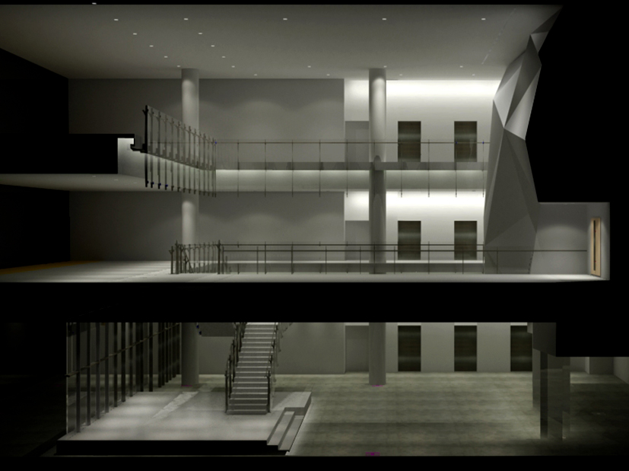
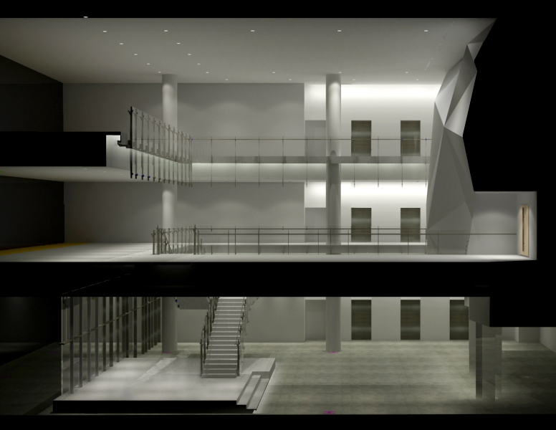
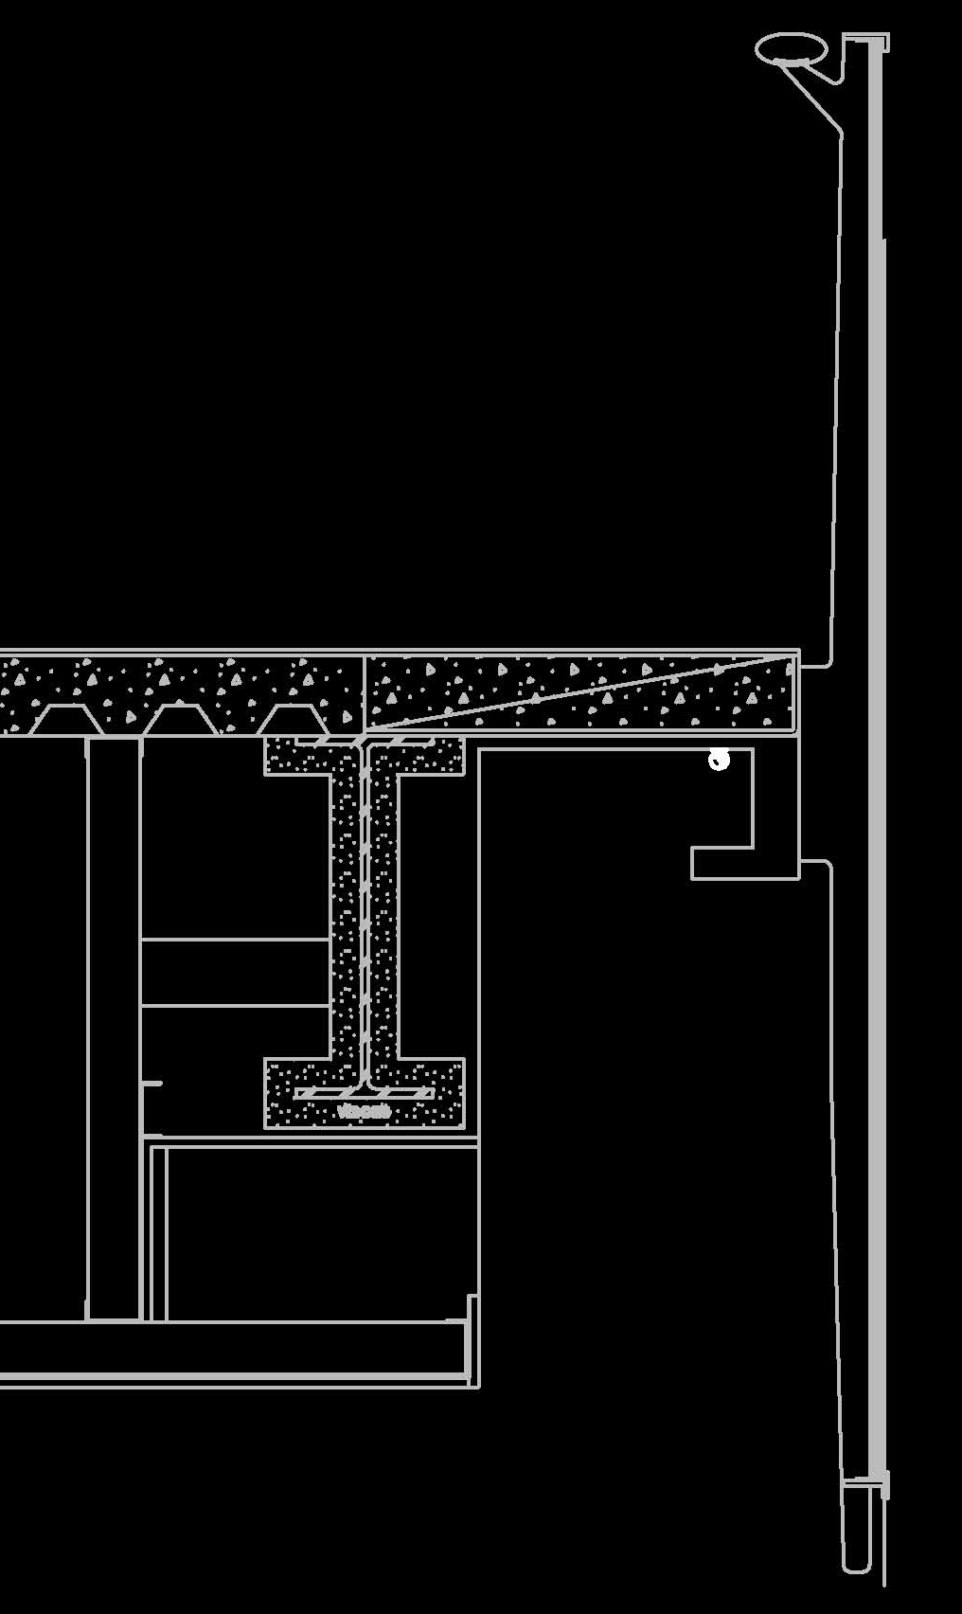
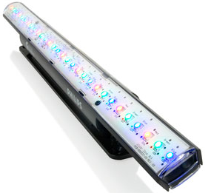
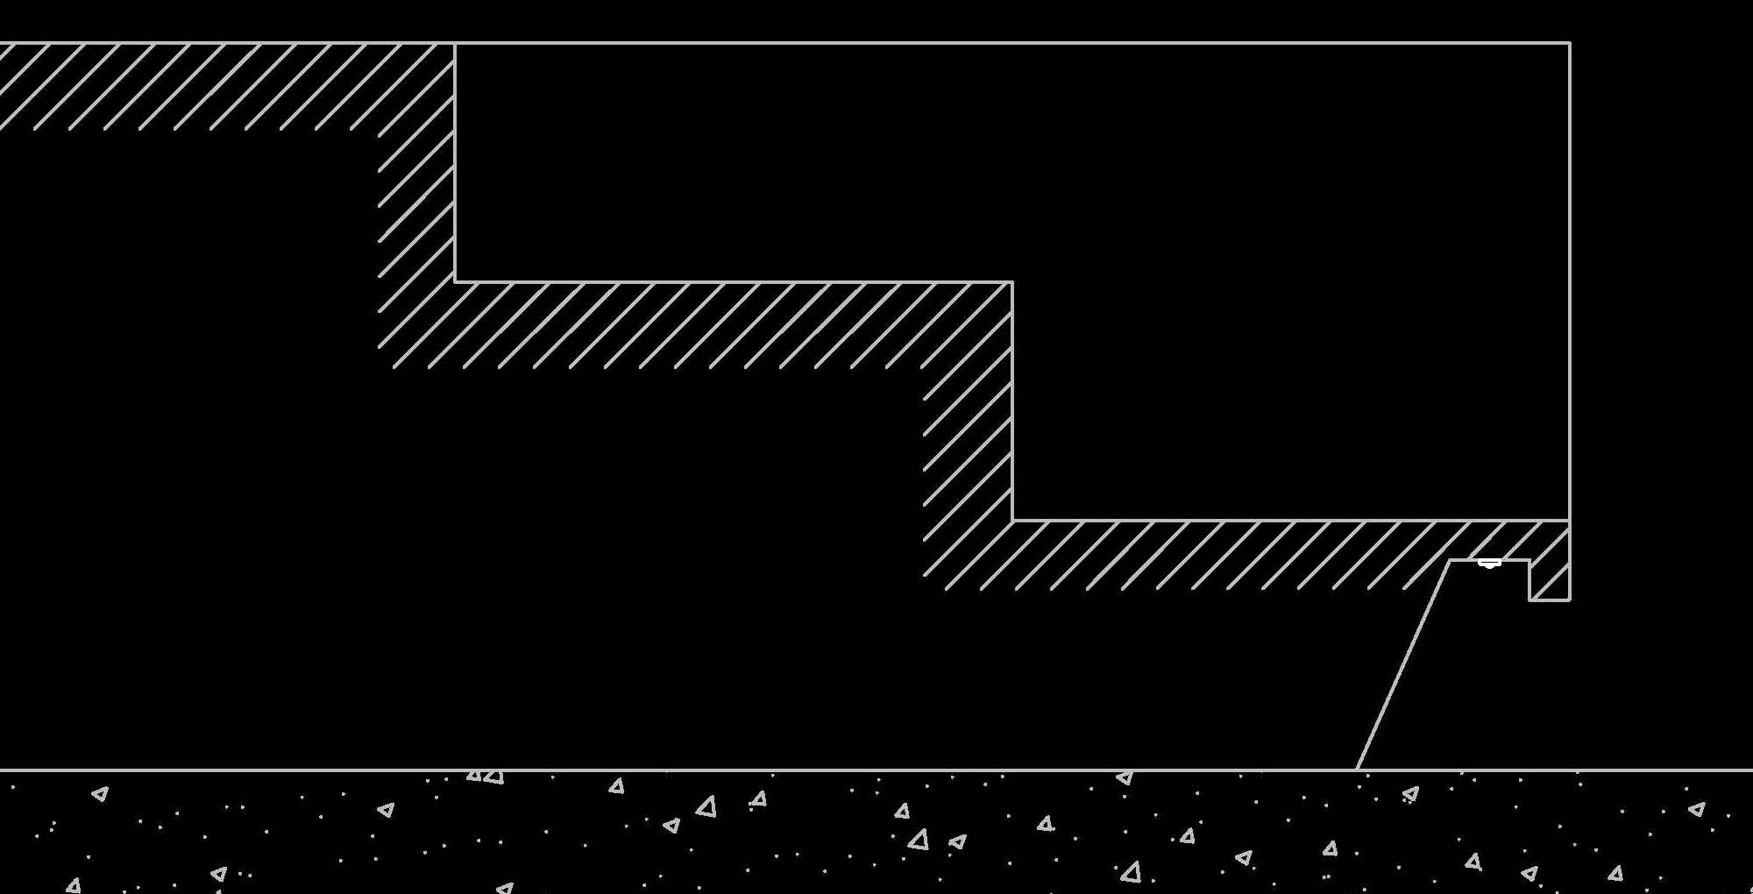
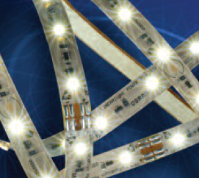
LIGHTING REDESIGN
LOBBY ATRIUM
O U T L I N E
Architectural Concept
Lighting Redesign
  Lobby Atrium
  Feinberg Theater
Daylighting Study
Electrical Depth
  Energy Efficient Loads
Breadth Study
  Acoustics
Linear RGB LED
Linear Flexible LED

Slide 20
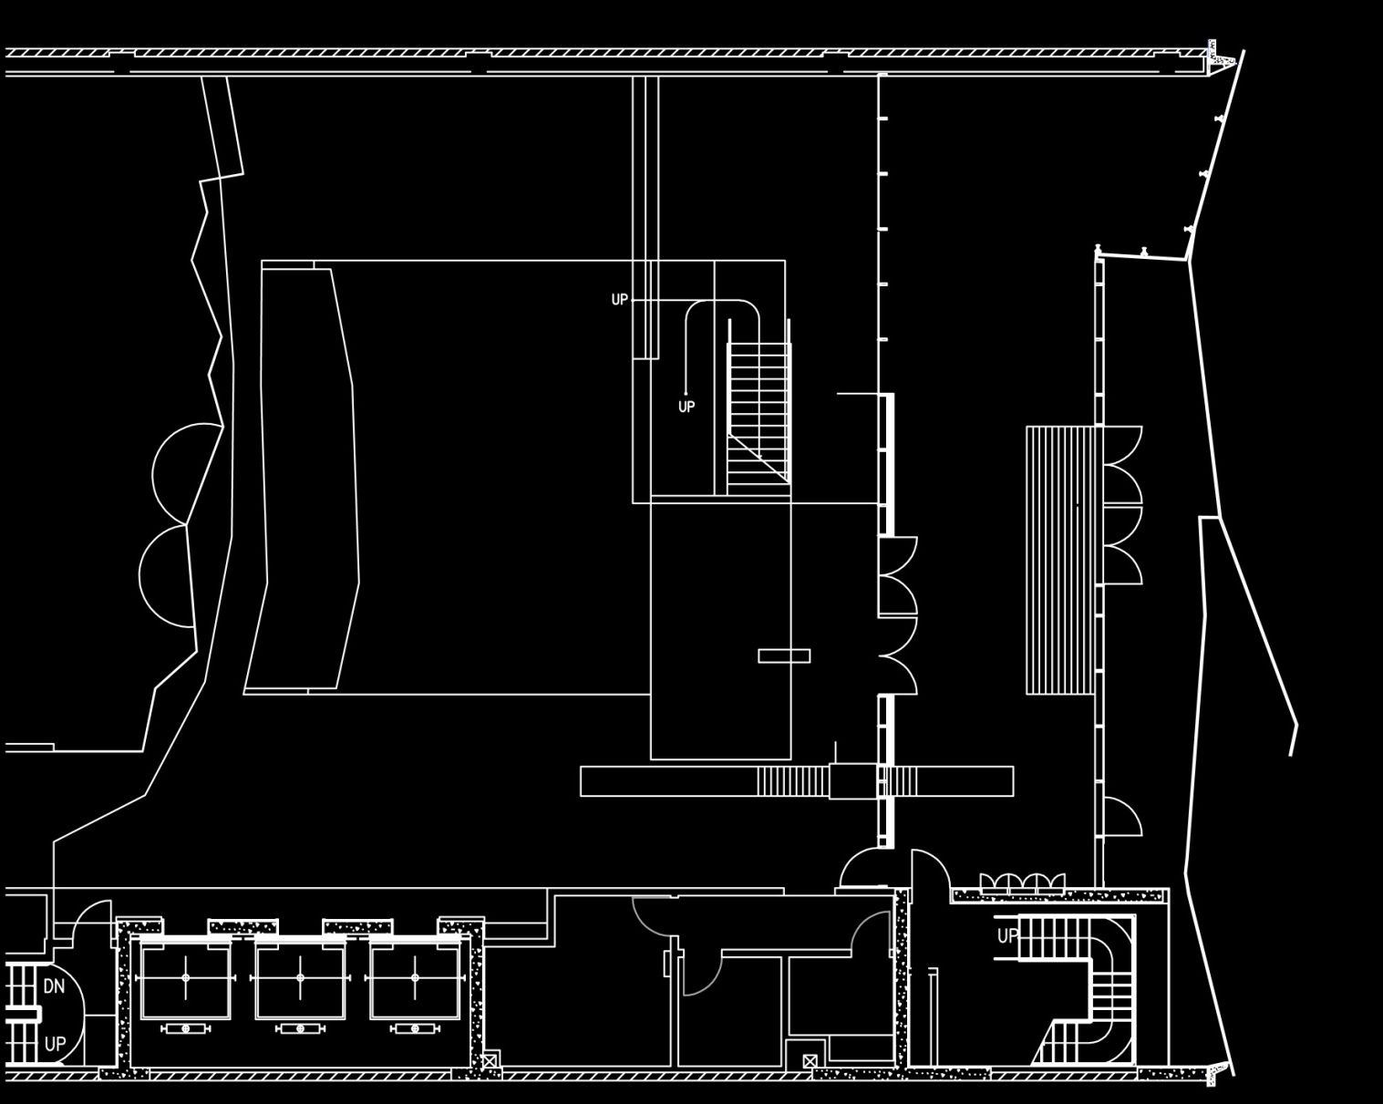

LIGHTING REDESIGN
LOBBY ATRIUM
O U T L I N E
Architectural Concept
Lighting Redesign
  Lobby Atrium
  Feinberg Theater
Daylighting Study
Electrical Depth
  Energy Efficient Loads
Breadth Study
  Acoustics

Slide 21
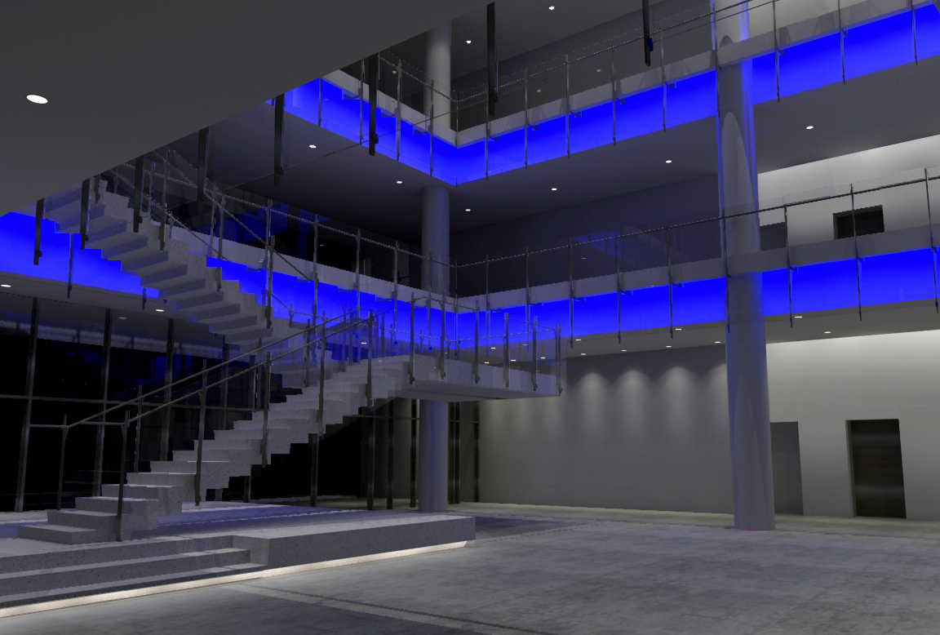
LIGHTING REDESIGN
LOBBY ATRIUM
O U T L I N E
Architectural Concept
Lighting Redesign
  Lobby Atrium
  Feinberg Theater
Daylighting Study
Electrical Depth
  Energy Efficient Loads
Breadth Study
  Acoustics

Slide 22
LIGHTING REDESIGN
LOBBY ATRIUM
O U T L I N E
Architectural Concept
Lighting Redesign
  Lobby Atrium
  Feinberg Theater
Daylighting Study
Electrical Depth
  Energy Efficient Loads
Breadth Study
  Acoustics

Slide 23
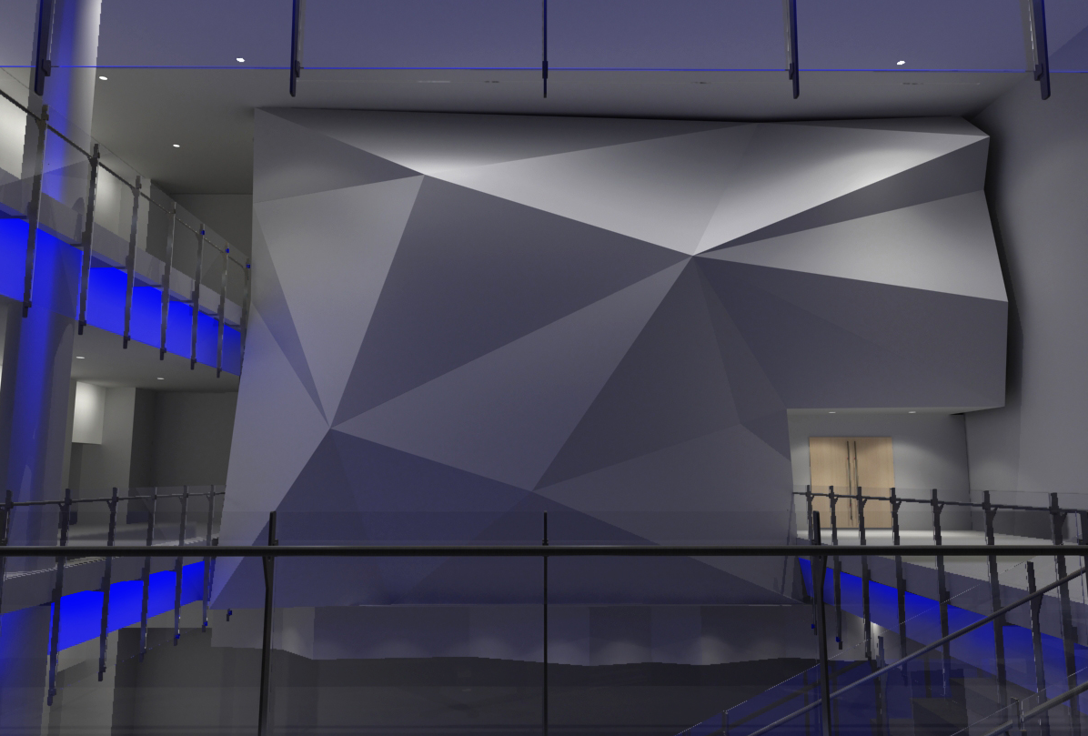
LIGHTING REDESIGN
LOBBY ATRIUM
O U T L I N E
Architectural Concept
Lighting Redesign
  Lobby Atrium
  Feinberg Theater
Daylighting Study
Electrical Depth
  Energy Efficient Loads
Breadth Study
  Acoustics

Slide 24
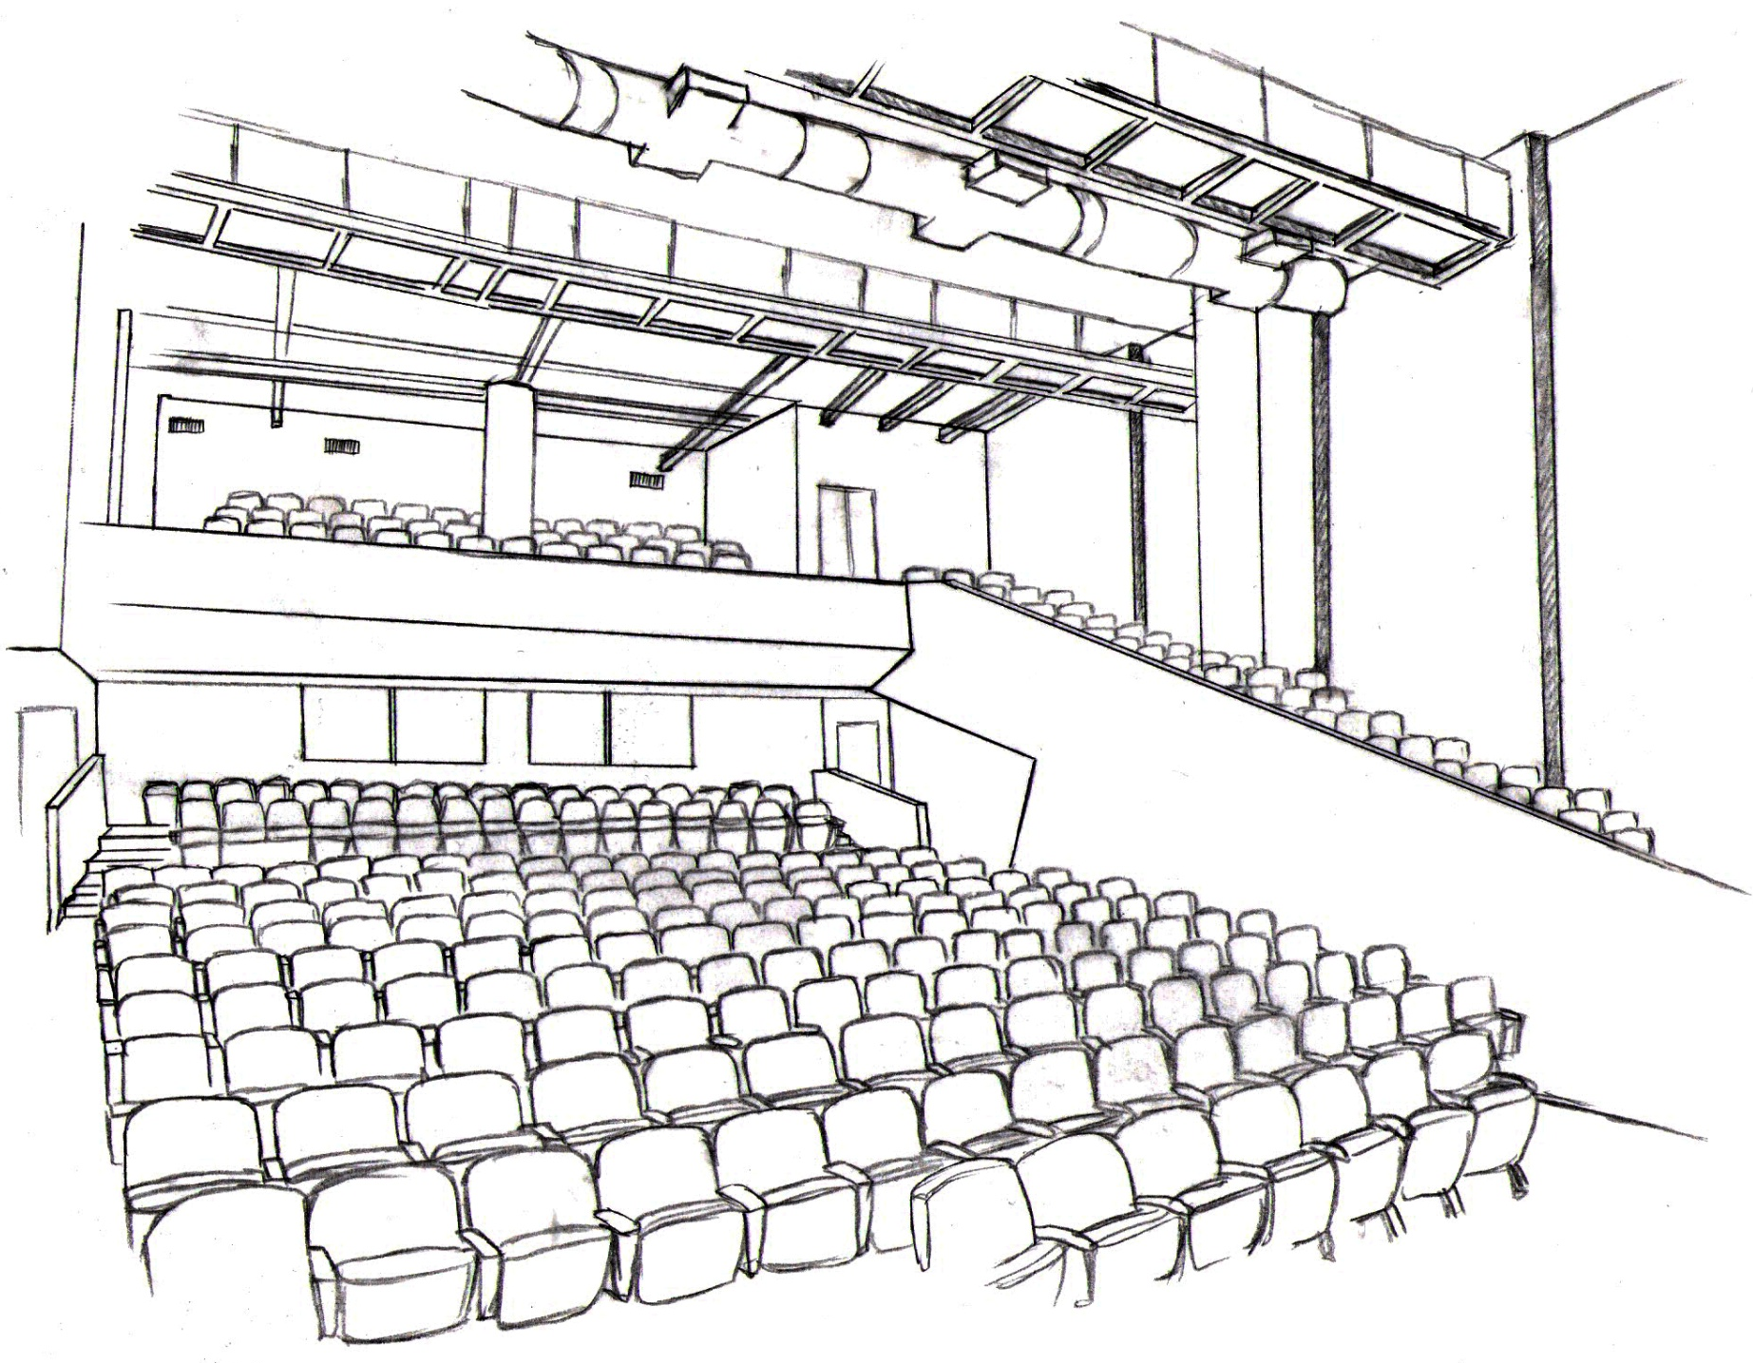
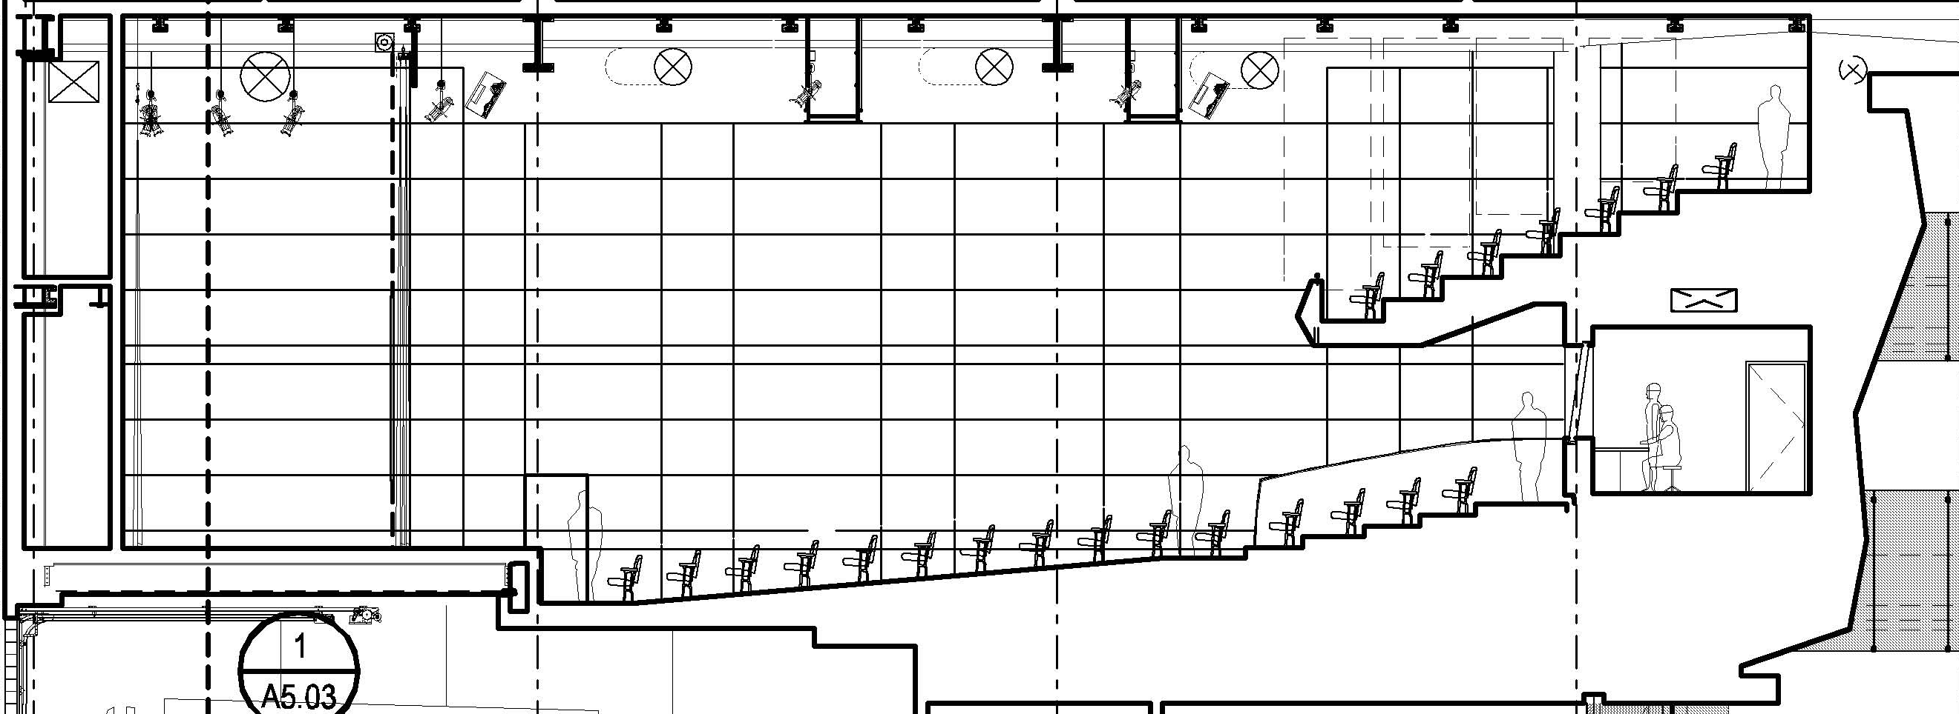
LIGHTING REDESIGN
FEINBERG THEATER
O U T L I N E
Architectural Concept
Lighting Redesign
  Lobby Atrium
  Feinberg Theater
Daylighting Study
Electrical Depth
  Energy Efficient Loads
Breadth Study
  Acoustics
Activities/Tasks
Lectures
Live Performances
Films
Capacity: 400 seats
THEATER
LOBBY

Slide 25
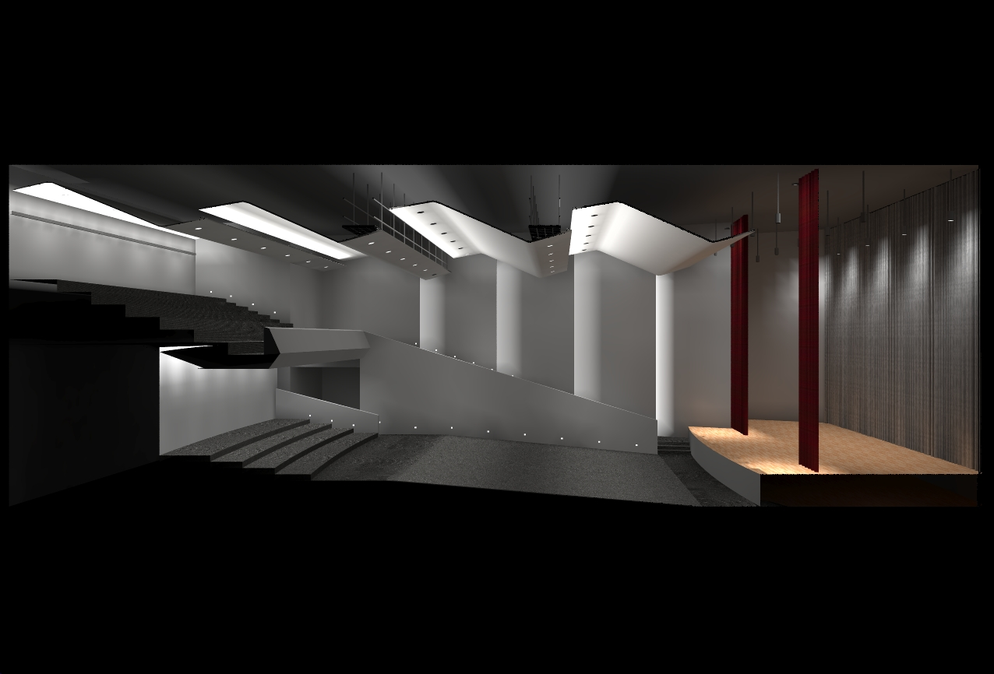
LIGHTING REDESIGN
FEINBERG THEATER
O U T L I N E
Architectural Concept
Lighting Redesign
  Lobby Atrium
  Feinberg Theater
Daylighting Study
Electrical Depth
  Energy Efficient Loads
Breadth Study
  Acoustics
Visual Environment
Defined Architectural Form
Color Appearance
Way-finding / Direction
Direct and reflected Glare
Visual Performance
System Control and Flexibility
  Lecture Mode – 30 FC
  Pre-show Mode – 10-20 FC
  Show-time Mode

Slide 26
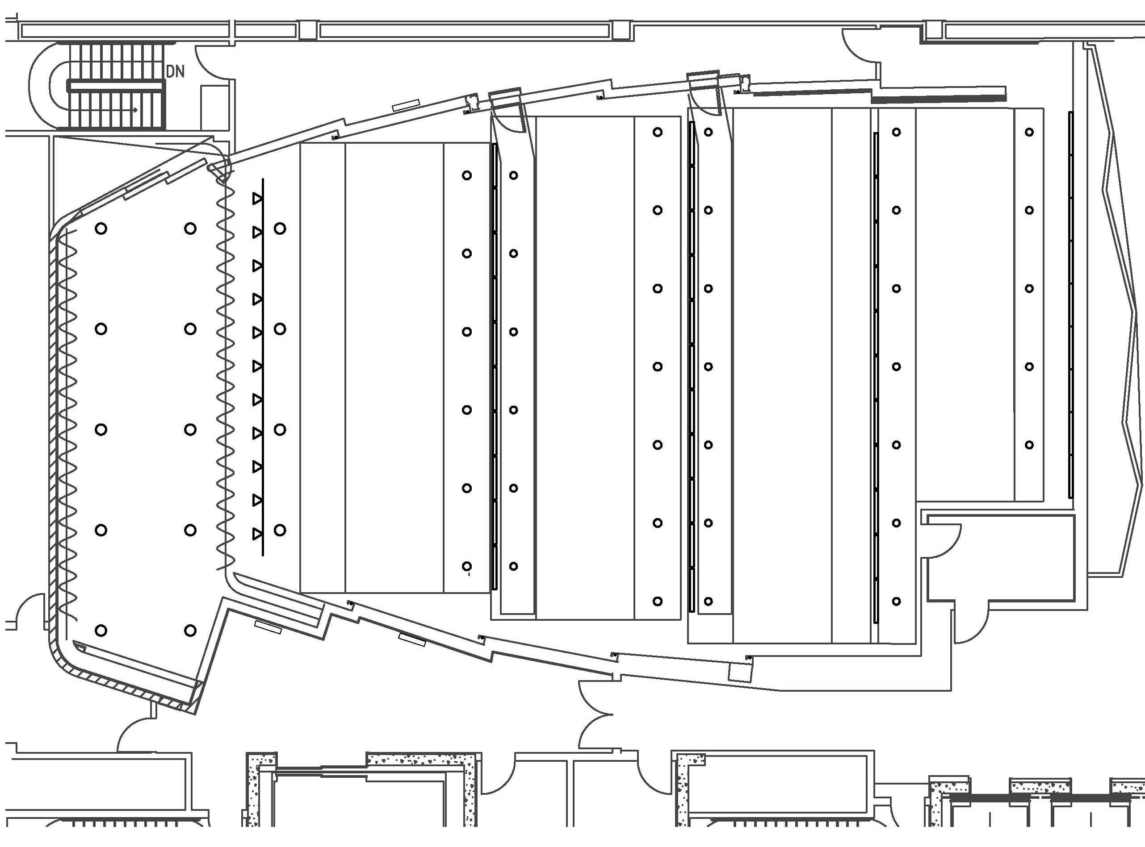
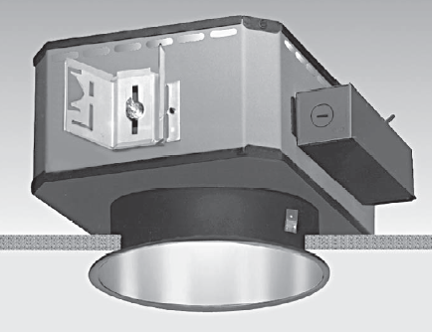
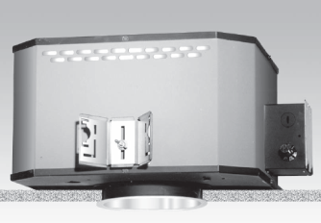
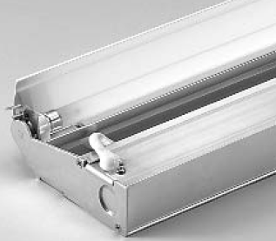
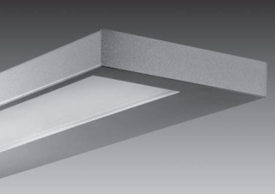
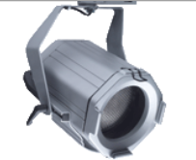
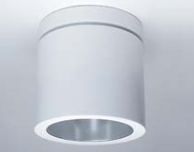
LIGHTING REDESIGN
FEINBERG THEATER
O U T L I N E
Architectural Concept
Lighting Redesign
  Lobby Atrium
  Feinberg Theater
Daylighting Study
Electrical Depth
  Energy Efficient Loads
Breadth Study
  Acoustics
(2) 42W CFL Recessed Downlight
100W PAR38 Halogen Recessed Downlight
T5HO Linear Fluorescent Cove
T5 Linear Fluorescent Indirect/Direct
Wall Mounted
100W PAR38 Halogen Track System
(2) 42W CFL Cylinder Downlight

Slide 27
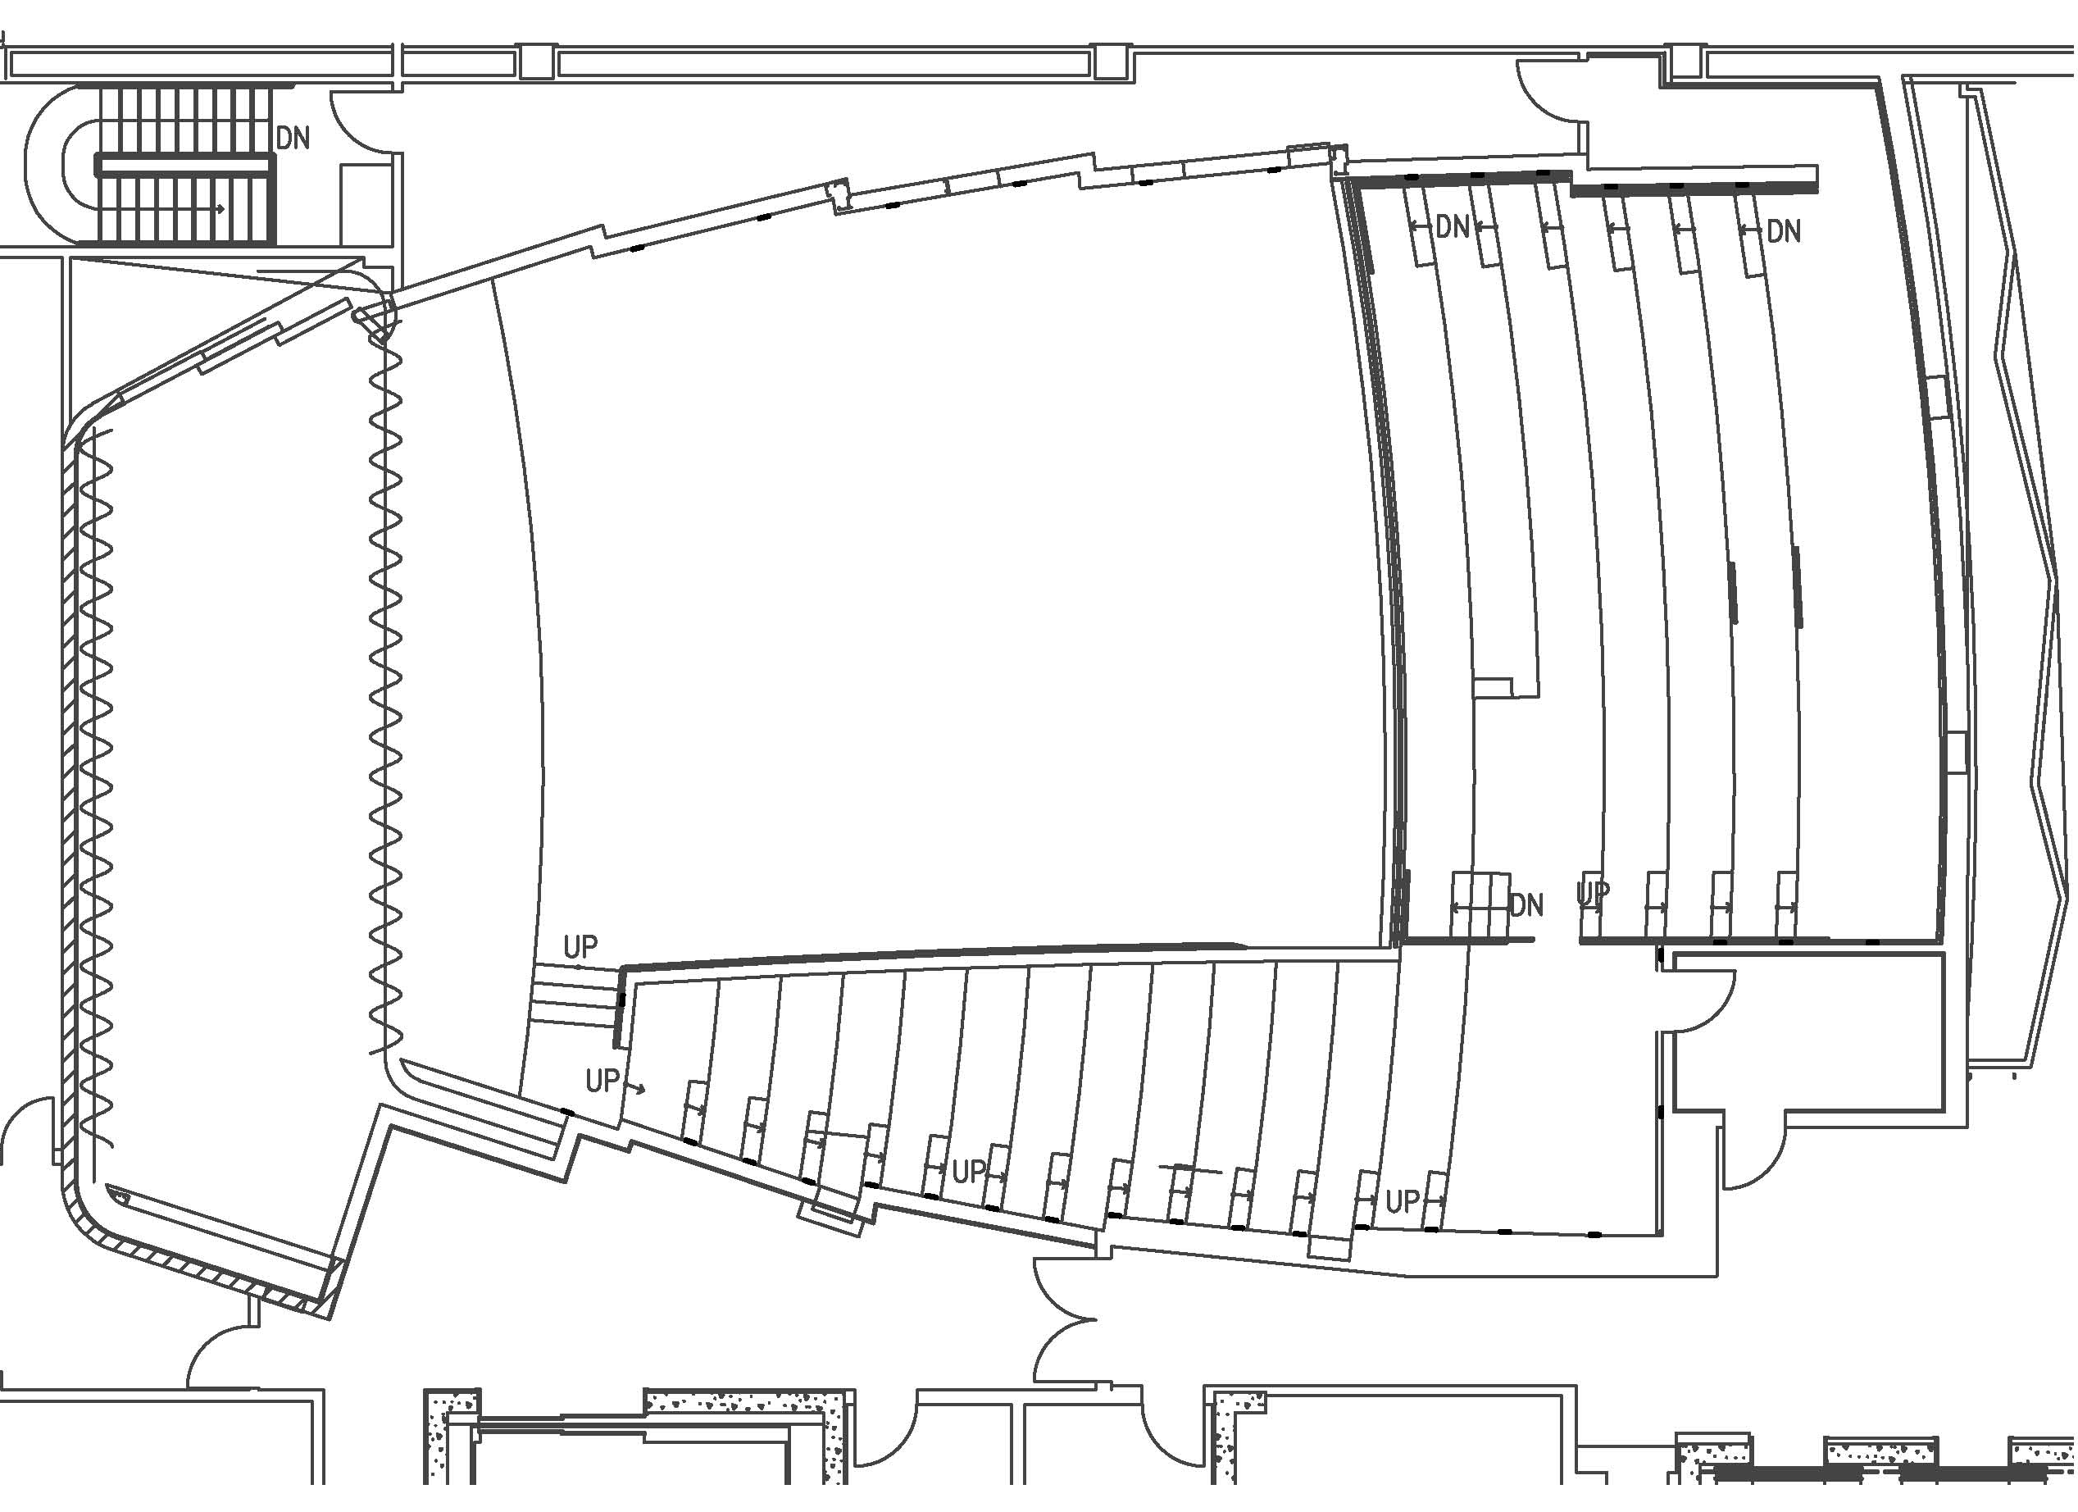
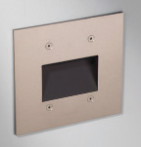
LIGHTING REDESIGN
FEINBERG THEATER
O U T L I N E
Architectural Concept
Lighting Redesign
  Lobby Atrium
  Feinberg Theater
Daylighting Study
Electrical Depth
  Energy Efficient Loads
Breadth Study
  Acoustics
Linear RGB LED
LED Steplight

Slide 28
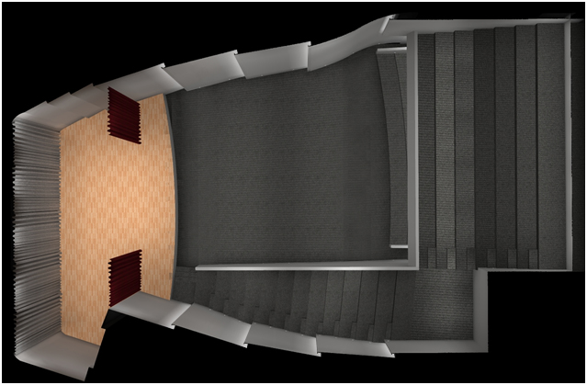
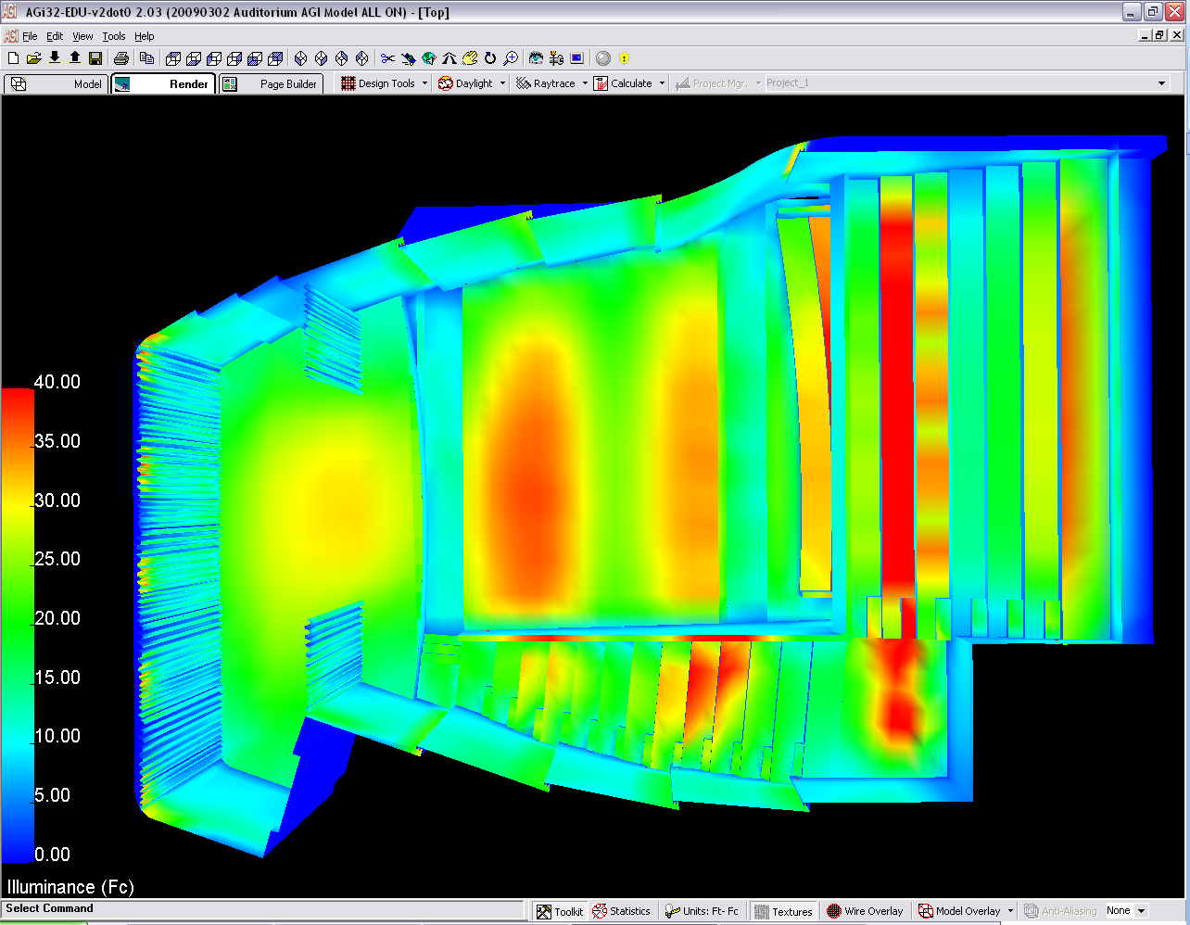
LIGHTING REDESIGN
FEINBERG THEATER
O U T L I N E
Architectural Concept
Lighting Redesign
  Lobby Atrium
  Feinberg Theater
Daylighting Study
Electrical Depth
  Energy Efficient Loads
Breadth Study
  Acoustics
Average Illuminance: 29 FC
Scene: Lecture I Pre-show I Show time
Type | F8 | F11 | F12 | F13 | F14 | F15 | F16 | F17 | F18 | F19 | F20
Light Level | 100% | 100% | 100% | 100% | 100% | 100% | 100% | 100% | 100% | 100% | 100%

Slide 29
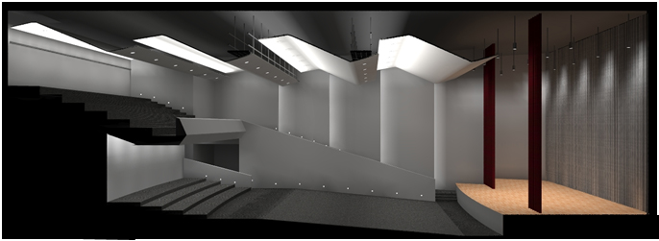
LIGHTING REDESIGN
FEINBERG THEATER
O U T L I N E
Architectural Concept
Lighting Redesign
  Lobby Atrium
  Feinberg Theater
Daylighting Study
Electrical Depth
  Energy Efficient Loads
Breadth Study
  Acoustics
Average Illuminance: 29 FC
Scene: Lecture I Pre-show I Show time
Type | F8 | F11 | F12 | F13 | F14 | F15 | F16 | F17 | F18 | F19 | F20
Light Level | 100% | 100% | 100% | 100% | 100% | 100% | 100% | 100% | 100% | 100% | 100%

Slide 30
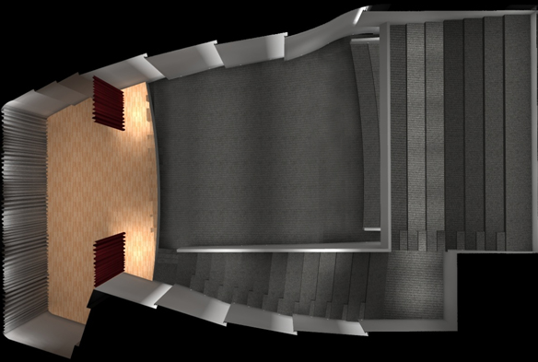
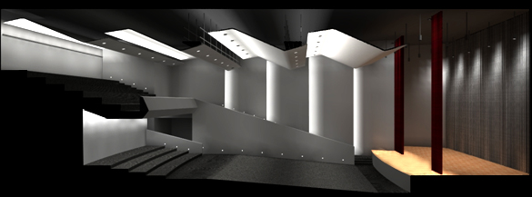
LIGHTING REDESIGN
FEINBERG THEATER
O U T L I N E
Architectural Concept
Lighting Redesign
  Lobby Atrium
  Feinberg Theater
Daylighting Study
Electrical Depth
  Energy Efficient Loads
Breadth Study
  Acoustics
Average Illuminance: 14 FC
Scene: Lecture I Pre-show I Show time
Type | F11 | F12 | F13 | F14 | F15 | F16 | F17 | F18 | F19 | F20
Light Level | off | 100% | 50% | 50% | 50% | 50% | 50% | 100% | 75% | 60%

Slide 31
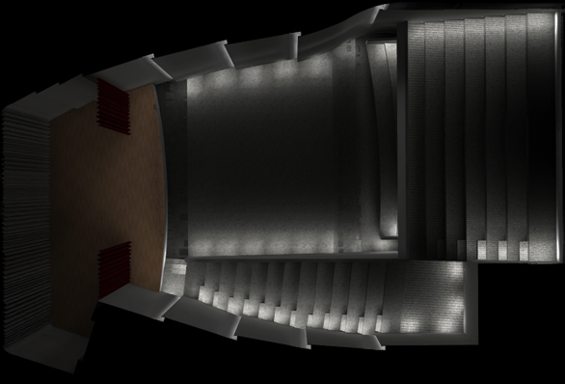

LIGHTING REDESIGN
FEINBERG THEATER
O U T L I N E
Architectural Concept
Lighting Redesign
  Lobby Atrium
  Feinberg Theater
Daylighting Study
Electrical Depth
  Energy Efficient Loads
Breadth Study
  Acoustics
Scene: Lecture I Pre-show I Show time
Type | F8 | F11 | F12 | F13 | F14 | F15 | F16 | F17 | F18 | F19 | F20
Light Level | 10% | off | off | off | off | off | off | off | 100% | off | vary

Slide 32




LIGHTING REDESIGN
FEINBERG THEATER
O U T L I N E
Architectural Concept
Lighting Redesign
  Lobby Atrium
  Feinberg Theater
Daylighting Study
Electrical Depth
  Energy Efficient Loads
Breadth Study
  Acoustics
100W PAR38 Halogen Downlight
(2)42W CFL Downlight
T5HO Linear Fluorescent

Slide 33




DAYLIGHTING STUDY
OPEN OFFICE
O U T L I N E
Architectural Concept
Lighting Redesign
  Lobby Atrium
  Feinberg Theater
Daylighting Study
Electrical Depth
  Energy Efficient Loads
Breadth Study
  Acoustics
Objective: To identify the most effective dimming configuration for
daylight harvesting, while maintain quality of light in the
space
Constrains >>
Location >>
Chicago
Latitude – 41°59'N
Longitude – 87°54'W
Materials >>
Façade Curtain Wall – Fritted Glass ( τ = .5)
Solar Shades – Fabric ( τ = .2)
Electric Lighting >>
Indirect/Direct Suspended Pendant
T5HO – 4400 lumens
30 FC on the workplace
Target Illuminance >>
N
N

Slide 34
DAYLIGHTING STUDY
OPEN OFFICE
O U T L I N E
Architectural Concept
Lighting Redesign
  Lobby Atrium
  Feinberg Theater
Daylighting Study
Electrical Depth
  Energy Efficient Loads
Breadth Study
  Acoustics
1 Row Dimming ( 6 Fixtures )
Options:
2 Rows Dimming (12 Fixtures )
}
Conditions:
Jan 21 st
Clear sky
1 Row Dimming
2 Rows Dimming
Overcast
1 Row Dimming
2 Rows Dimming
Mar 21 st
Clear sky
1 Row Dimming
2 Rows Dimming
Overcast
1 Row Dimming
2 Rows Dimming
12 Conditions
May 21 st
Clear sky
1 Row Dimming
2 Rows Dimming
Overcast
1 Row Dimming
2 Rows Dimming
N
N

Slide 35
DAYLIGHTING STUDY
OPEN OFFICE
O U T L I N E
Architectural Concept
Lighting Redesign
  Lobby Atrium
  Feinberg Theater
Daylighting Study
Electrical Depth
  Energy Efficient Loads
Breadth Study
  Acoustics
Conclusion:
 | 1-row dimming (6 fixtures) |  | 2-rows dimming (12 fixtures)
 | Clear | Overcast | Clear | Overcast
Dimming Level | 0.63 | 0.479 | 0.90 | 0.906
Watts Saving | 119 | 171 | 65 | 62
% Saving | 6 | 9 | 3 | 3
Avg % Saving | 7.8 |  | 3.4
Preferred Option | ✓ |  | ✗
 | 1-row dimming (6 fixtures) |  | 2-rows dimming (12 fixtures)
 | Clear | Overcast | Clear | Overcast
Dimming Level | 0.62 | 0.186 | 0.90 | 0.856
Watts Saving | 122 | 266 | 65 | 94
% Saving | 7 | 14 | 3 | 5
Avg % Saving | 10.4 |  | 4.3
Preferred Option | ✓ |  | ✗
 | 1-row dimming (6 fixtures) |  | 2-rows dimming (12 fixtures)
 | Clear | Overcast | Clear | Overcast
Dimming Level | 0.66 | 0 | 0.91 | 0.819
Watts Saving | 109 | 327 | 57 | 118
% Saving | 6 | 18 | 3 | 6
Avg % Saving | 11.7 |  | 4.7
Preferred Option | ✓ |  | ✗
1 Row Dimming can save more energy for all conditions
Jan 21st
Peak energy saving is 18% on May 21st during the
overcast condition
Average energy saving is 10%
Mar 21st
May 21st
N

Slide 36
ELECTRICAL DEPTH
ENERGY EFFICIENT LOADS
O U T L I N E
Architectural Concept
Lighting Redesign
  Lobby Atrium
  Feinberg Theater
Daylighting Study
Electrical Depth
  Energy Efficient Loads
Breadth Study
  Acoustics
Objective: Utilizing energy efficient light sources to downsize electrical
equipment and reduce operating costs, while maintain quality
of light and the integrity of the design
N

Slide 37


ELECTRICAL DEPTH
ENERGY EFFICIENT LOADS
O U T L I N E
Architectural Concept
Lighting Redesign
  Lobby Atrium
  Feinberg Theater
Daylighting Study
Electrical Depth
  Energy Efficient Loads
Breadth Study
  Acoustics
Gift Shop
20W T4.5 Ceramic Metal Halide
50&100W PAR30 Halogen
Quantity: 105 Fixtures
N

Slide 38


ELECTRICAL DEPTH
ENERGY EFFICIENT LOADS
O U T L I N E
Architectural Concept
Lighting Redesign
  Lobby Atrium
  Feinberg Theater
Daylighting Study
Electrical Depth
  Energy Efficient Loads
Breadth Study
  Acoustics
General illumination throughout the building
18W T4 Compact Fluorescent
50W MR16 Halogen
N

Slide 39
ELECTRICAL DEPTH
ENERGY EFFICIENT LOADS
O U T L I N E
Architectural Concept
Lighting Redesign
  Lobby Atrium
  Feinberg Theater
Daylighting Study
Electrical Depth
  Energy Efficient Loads
Breadth Study
  Acoustics
Resizing Panelboards
>> 7 Panelboards are affected
N

Slide 40
ELECTRICAL DEPTH
ENERGY EFFICIENT LOADS
O U T L I N E
Architectural Concept
Lighting Redesign
  Lobby Atrium
  Feinberg Theater
Daylighting Study
Electrical Depth
  Energy Efficient Loads
Breadth Study
  Acoustics
Resizing Panelboards
>> 7 Panelboards are affected
PANELBOARD | REDUCED AMPS
L1 | 40
L2 | 27
L3 | 18
5L-2 | 34
9L-4 | 10
9L-7 | 7
9L-9 | 2
TOTAL AMPS SAVING | 138
TOTAL VA SAVING | 16560
14 hrs/day, 365 days/year @ $0.095 /KW hr
TOTAL ANNUAL ENERGY (KW hr) SAVING | 84621.6
TOTAL ANNUAL ENERGY COST SAVING ($) | 8039.05
Amps
Panelboard#
Total Annual Energy Saving 85,000 KW hr or $ 8,040
N

Slide 41
ELECTRICAL DEPTH
ENERGY EFFICIENT LOADS
O U T L I N E
Architectural Concept
Lighting Redesign
  Lobby Atrium
  Feinberg Theater
Daylighting Study
Electrical Depth
  Energy Efficient Loads
Breadth Study
  Acoustics
>> from General Panelboards to Lighting Panelboards
Resizing Feeders
($)
$7005
$4650
Total Initial Cost Saving: $ 2,355
N

Slide 42
BREADTH STUDY
ACOUSTICS
O U T L I N E
Architectural Concept
Lighting Redesign
  Lobby Atrium
  Feinberg Theater
Daylighting Study
Electrical Depth
  Energy Efficient Loads
Breadth Study
  Acoustics
Objective: Analyze and Redesign of Feinberg Theater Acoustics
Design Criterions:
Multipurpose Auditorium
Compromise reverberation time
  for speech and instrumental music and chorus
Mid-frequency reverberation of 1.7 at 500 Hz
1.3 and 0.8 multiplier for 125 and 4000 Hz
Sound reinforcement
 | Frequency (Hz)
 | 125 | 500 | 4000
Target | 2.21 | 1.7 | 1.36
N

Slide 43



BREADTH STUDY
ACOUSTICS
O U T L I N E
Architectural Concept
Lighting Redesign
  Lobby Atrium
  Feinberg Theater
Daylighting Study
Electrical Depth
  Energy Efficient Loads
Breadth Study
  Acoustics
Existing Condition
Proposed Design
N

Slide 44
Results Summary
Lighting :
Lighting redesign successfully provides quality lighting and reinforces the architecture of the space through the use of energy efficient equipments and flexible control systems.
Electrical:
Both the initial and operating costs are reduced through the use of energy efficient light sources and equipments.
Acoustics:
Acoustical performance including reverberation times and sound projection are improved through the proposed ceiling panels.
N

Slide 45

SPECIAL THANKS:
&
Primary project team:
Owner:
Architects:
MEP/FP & Tel/Data:
Lighting Design:
Structural Engineer:
General Contractor:
Spertus Institute of Jewish Studies
Krueck+Sexton Architects
Environmental Systems Design
ISP Design Inc. / Schuler Shook
Tylk Gustafson Reckers Wilson Andrews
W.E. O’Neil Construction Co.
Professor Houser
Professor Mistrick
Professor Dannerth
Professor Holland
Professor Parfitt
Family + Fellow AEs
Advisors:

Slide 46

QUESTIONS I COMMENTS

